Slide 1
Perscient
Perscient AI Pulse Chartbook
August 4, 2026

Slide 2
Executive Summary
FOUR THINGS TO REMEMBER FROM THIS WEEK'S AI NARRATIVE LANDSCAPE
01
The bottleneck story has been rewritten around memory and physical infrastructure.
Memory-shortage language hit 459.4, the densest reading we track, while GPU-scarcity sat flat at 4.4. Data-center-delay density jumped 21.3 points in a single week. The constraint narrative now centers on DRAM allocation, transformer lead times, and zoning-board resistance.
02
Skepticism is being priced as market risk, not technology disappointment.
AI-bubble-crash language surged 17.3 to 133.8 and buyer-skepticism density rose 16.8 to 92.1, yet classic disillusionment framings stayed subdued or negative. Media concede the spending but dispute the payoff, with financing structure and earnings-bubble distinctions carrying the argument.
03
Expansion and doubt are now reported simultaneously.
Massive-capex language eased only 3.4 to 67.9 and hyperscale-expansion predictions held flat, even alongside the collapse-framing surge. CreditSights projects $750 billion in 2026 hyperscaler capex, up from $620 billion estimated in January.
04
A token price war has fragmented competitive coverage.
Anthropic-leads density fell 64.4 from 266.1 while DeepSeek-or-China posted the group's sharpest gain at +13.9. V4-Flash matches Claude Opus 4.8 on coding tasks at roughly $0.28 versus $25 per equivalent output. Falling unit costs arrive exactly as AI budgets face peak scrutiny.

Slide 3
STORY ONE
From Chips to Memory, Substations, and Zoning Boards
The constraint narrative moves from accelerators to DRAM, power queues, and local resistance

Slide 4
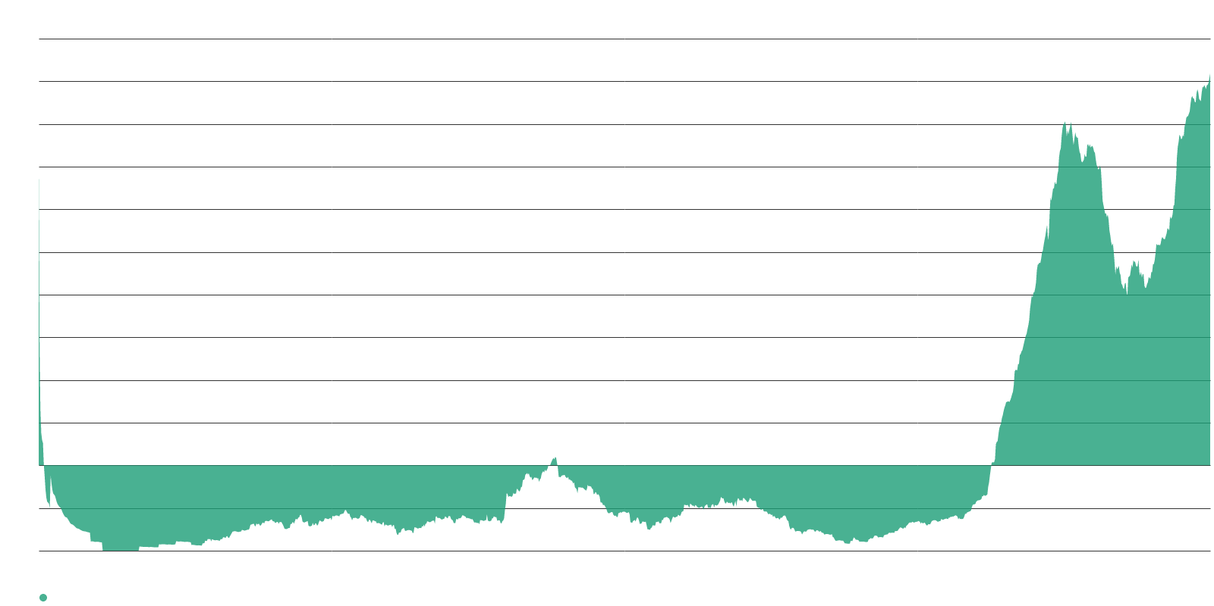
Memory scarcity has become AI's defining supply-chain story.
RAM SHORTAGE SIGNATURE — WEEK'S STRONGEST READING
459.4
RAM shortage signature — densest of all tracked
+13.7
Week-over-week gain
4.4
GPU shortage signature — flat at long-term norm
The GPU era is over as a narrative driver. Media coverage of what constrains AI has moved almost entirely from accelerators to DRAM and high-bandwidth memory. SK Hynix's CEO expects the crunch to persist beyond 2030, DRAM spot prices are up nearly 700% over the past year, and memory now accounts for roughly 35% of laptop material costs.
Samsung, supplying about a third of global memory, told investors the shortage will likely intensify in 2027 and persist until at least 2028. Frontier labs now share medium- and long-term demand forecasts directly with Samsung to lock in allocation. The bottleneck has shifted from design to procurement — and procurement timelines are measured in years, not quarters.

Slide 5
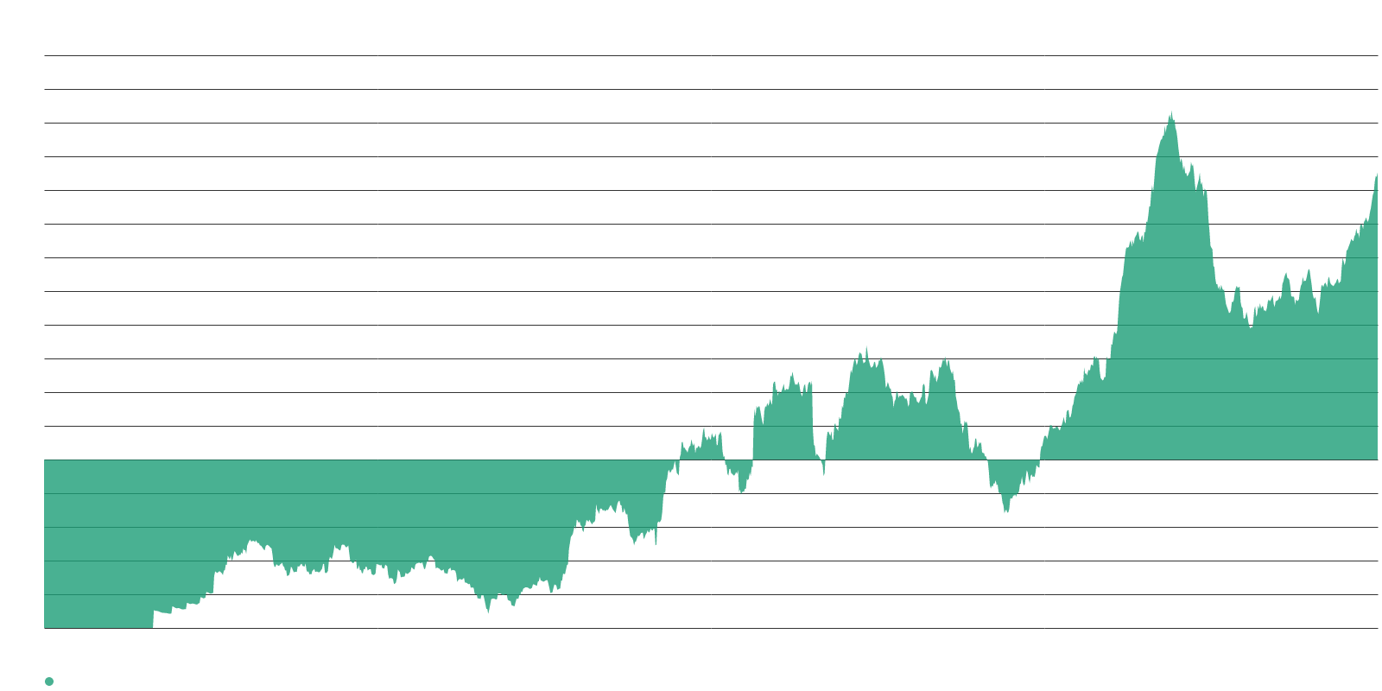
Data-center delays posted the week's sharpest single-signature jump.
INFRASTRUCTURE BOTTLENECK SIGNATURES
170.8
Data-center build-delay signature
+21.3
Largest weekly gain of any signature this period
160+
Weeks — substation transformer lead time
Physical infrastructure, not silicon, is the gating factor. PJM figures show AI infrastructure projects entering service in 2025 took an average of more than seven years end to end. Interconnect-delay language eased somewhat but remains among the most elevated readings in the set.
SemiAnalysis argues that widely cited cancellation figures overstate the problem, since almost all flagged capacity sits in the early-stage "announced" bucket. The counterargument matters — but the narrative momentum is with the delays, not the debunkers.

Slide 6
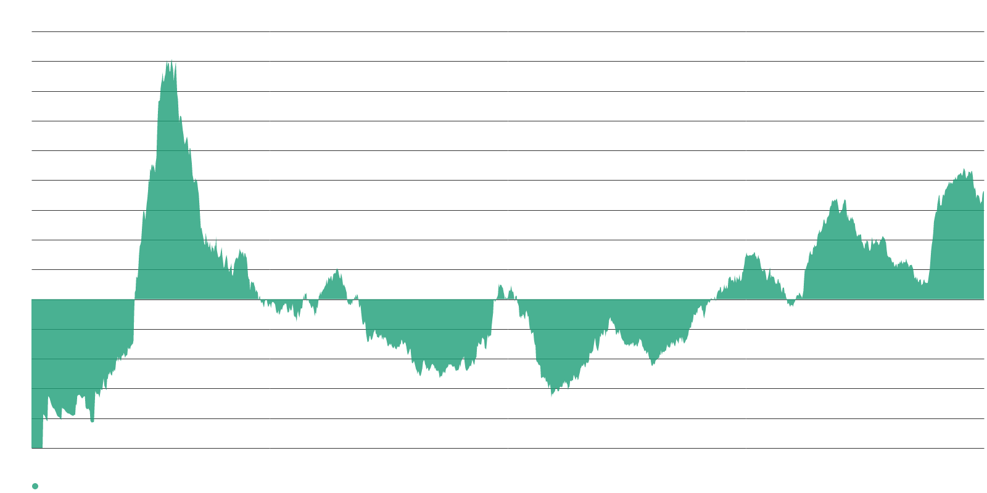
Local opposition to AI infrastructure is climbing and broadening.
RESISTANCE SIGNATURE AND POLICY LANDSCAPE
72.7
Resistance-to-big-AI-projects signature
41%
Americans opposing a data center within 3 miles
$130B
Cumulative value of projects delayed or blocked in Q1
Opposition has gone from episodic to structural. Half of Maryland jurisdictions have imposed a moratorium over electric rates, noise, and water use. A July Politico poll found opposition at 41%, up from 28% in January, spanning party lines. Brookings counts at least 15 states weighing pauses and more than 100 localities that have already approved them.
New York became the first state to impose a moratorium by executive order. At least 75 projects worth $130 billion were delayed or blocked in Q1 2026 alone. Permitting risk is no longer a footnote in the AI infrastructure story — it is becoming a headline constraint.

Slide 7
STORY TWO
Doubt Is Being Priced as Market Risk
Financial-collapse framing surges while classic disillusionment stays dormant

Slide 8
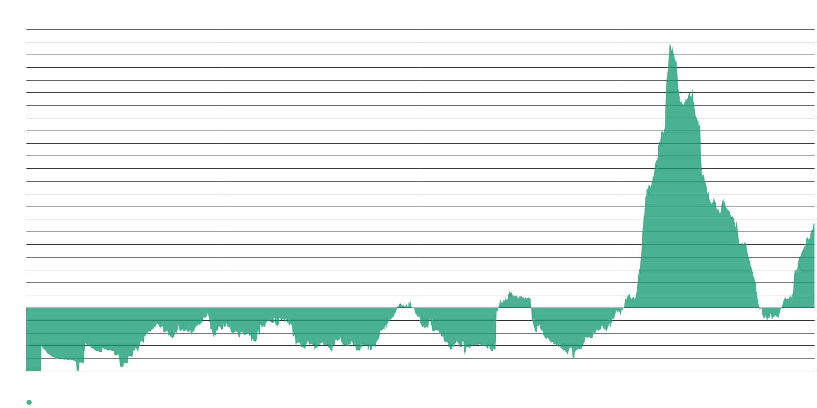
AI-bubble language is now the strongest market-framing signature we track.
MARKET-RISK AND SKEPTICISM SIGNATURES
133.8
AI-bubble-crash signature
+17.3
Week-over-week — second-largest increase in set
92.1
Buyer-skepticism signature
The doubt has bifurcated. Ray Dalio warned that AI enthusiasm echoes 1929 and 2000, endorsing Jeremy Grantham's characterization of a "bubble within a bubble." Goldman Sachs countered on August 3 that there is no valuation bubble but there may be an earnings bubble — shifting the risk from price levels to the durability of earnings growth.
Jim Covello estimated the world will have spent north of $3 trillion on AI by end of 2026 against "very disappointing" enterprise adoption. Anthropic has confidentially filed for a listing expected as early as October at a valuation near $1 trillion, while OpenAI's debut has slipped toward 2027.

Slide 9
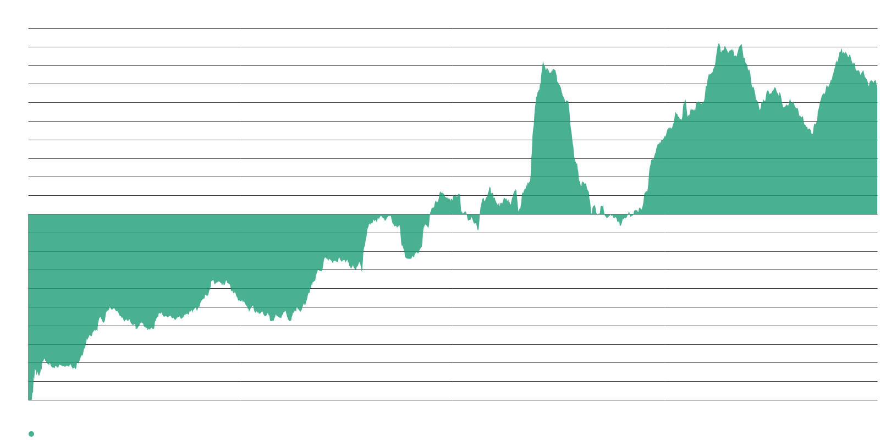
Spending density barely budged — expansion and doubt coexist in real time.
CAPEX AND HYPERSCALE EXPANSION SIGNATURES
67.9
AI-spending-is-massive signature
$750B
CreditSights 2026 hyperscaler capex projection
93%
AI capex as share of hyperscaler CFO — up from 33% in 2023
The spending narrative has not broken. AI-capex language eased by only 3.4 points and the hyperscale-expansion signature held flat, even as collapse framing surged. CreditSights now projects $750 billion in 2026 capex for the top five hyperscalers, up from $620 billion estimated in January — a third consecutive year of growth above 60%.
J.P. Morgan notes that AI capex has gone from 33% of hyperscalers' cash flow from operations in 2023 to an estimated 93% in 2026. Critics like Ed Zitron point to over $300 billion in debt and more than $1.4 trillion in off-balance-sheet commitments. Financing structure is becoming the bears' preferred terrain.

Slide 10
Classic disillusionment framings remain dormant despite the skepticism surge.
DISILLUSIONMENT AND ROI SIGNATURES
-17.9
Hype-to-disappointment signature — subdued
57%
Enterprise AI leaders whose ROI trails investment
Flat
Dot-com fiber analogy signature — week-over-week
This is not a disillusionment cycle in the classic sense. The hype-to-disappointment signature sits at -17.9, the dot-com analogy is flat, and the productivity-gains-missing signature held steady. A survey of 639 senior enterprise AI leaders found 57% still failing to outpace investment, even as 93% reported improved production capabilities.
The Federal Reserve's July 17 note cautions that the absence of an aggregate productivity signal in 2026 would not invalidate future impacts, since measured gains from general-purpose technologies historically lag investment by years. Coverage is granting the spending but not the payoff — and the competitive-urgency argument is not being deployed to offset the doubt.

Slide 11
STORY THREE
The Leaderboard Fragments Around Price
A token price war reshapes competitive coverage as Anthropic's listing window nears

Slide 12
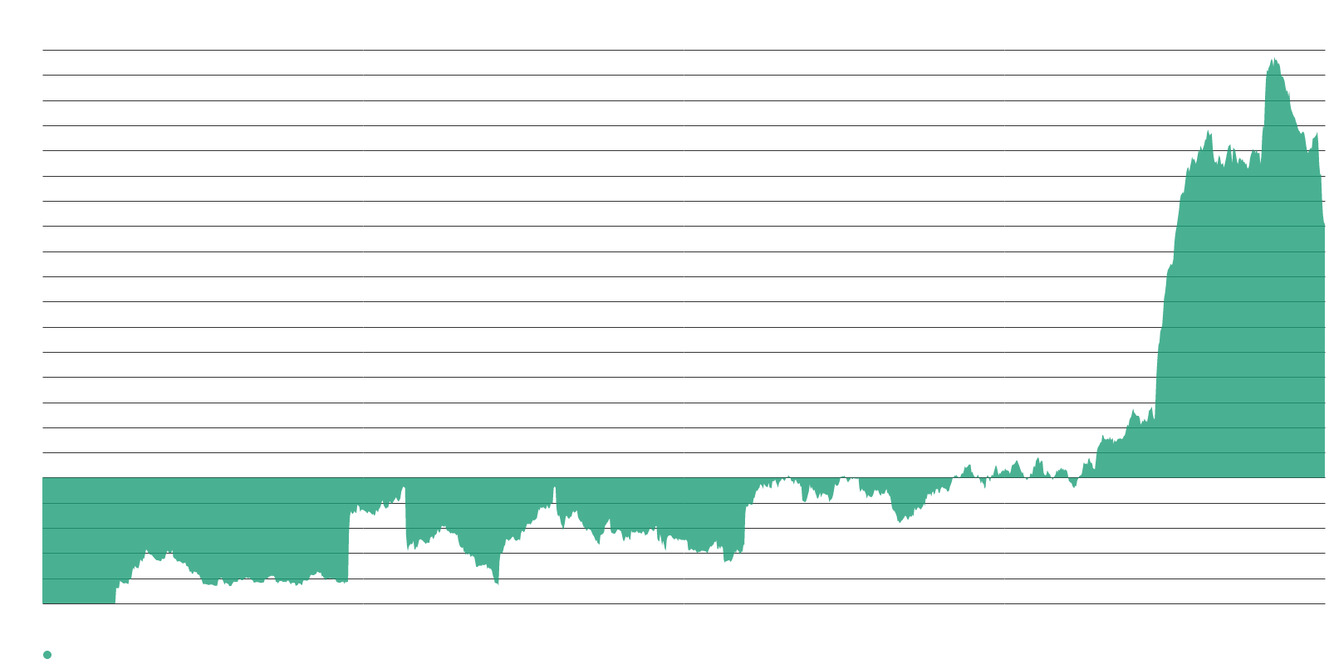
Anthropic's narrative lead remains dominant but shed a quarter of its density.
COMPETITIVE LEADERSHIP SIGNATURES
201.7
Anthropic-leads signature — still strongest
-64.4
Week-over-week decline from 266.1
<0
OpenAI and Google leadership — both negative
Enterprise distribution, not benchmarks, sustains the Anthropic lead. Cognizant expanded its partnership with Anthropic on July 27 to embed Claude across its platforms and scale a Claude-certified workforce. Claude Sonnet 5 carries introductory pricing of $2 per million input tokens and $10 per million output tokens through August 31.
OpenAI and Google leadership framings both weakened further into negative territory, leaving Anthropic as the only Western lab with positive competitive-leadership language this week.

Slide 13
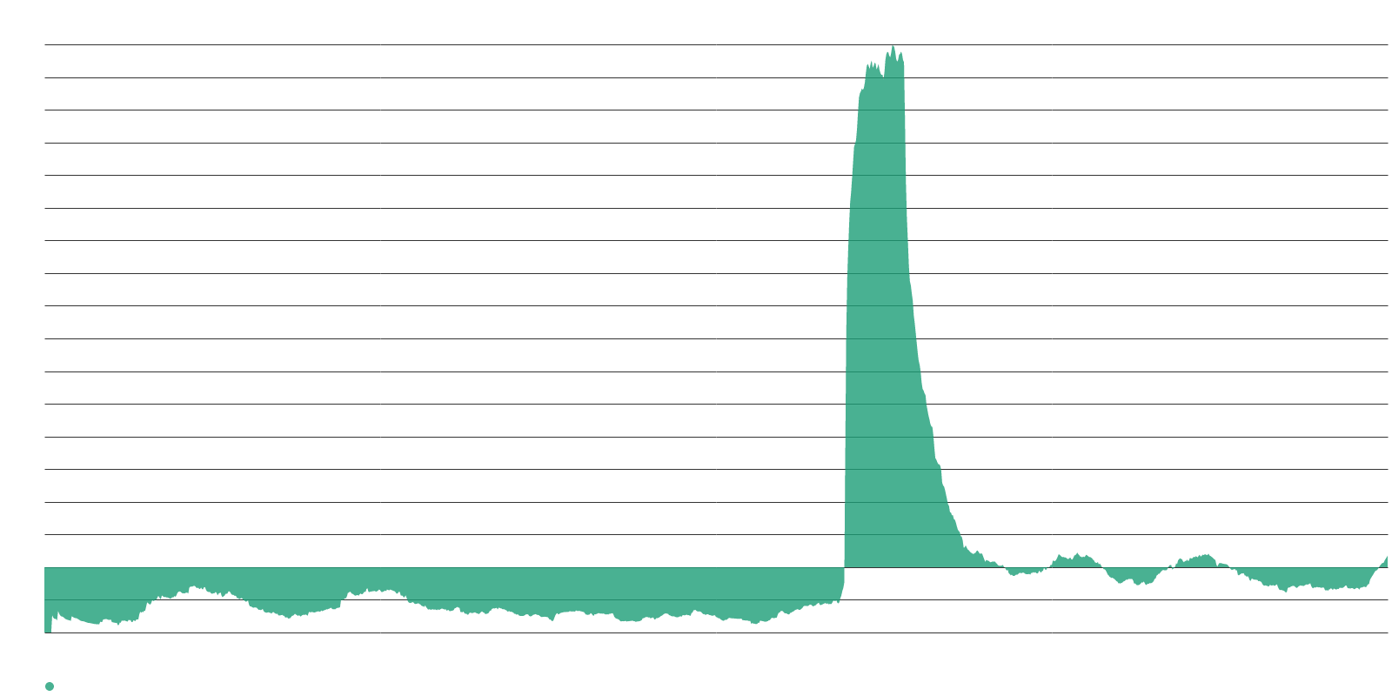
DeepSeek's V4-Flash release drove the competitive group's sharpest move.
DEEPSEEK AND CHINA COMPETITIVE SIGNATURE
17.7
DeepSeek-or-China signature — sharpest gain in group
+13.9
Week-over-week from near-neutral
$0.28
V4-Flash cost vs. $25 for comparable Claude output
Pricing, not capability, is now the competitive story. V4-Flash performs close to Claude Opus 4.8 on complex coding and autonomous software tasks at roughly 28 cents versus $25 for equivalent output. OpenAI cut GPT-5.6 Luna by 80% three weeks after launch, Google released three efficiency-focused Gemini flash models, and Grok 4.5 shipped.
At one moment in mid-July, six of the top ten models on developer usage rankings — and all of the top five — came from Chinese companies. Meituan claimed its LongCat-2.0 was trained entirely on Chinese-made processors. The price war arrives in the same week buyer-skepticism density peaked — falling unit costs strengthen procurement leverage precisely when AI budgets face the most scrutiny.

Slide 14
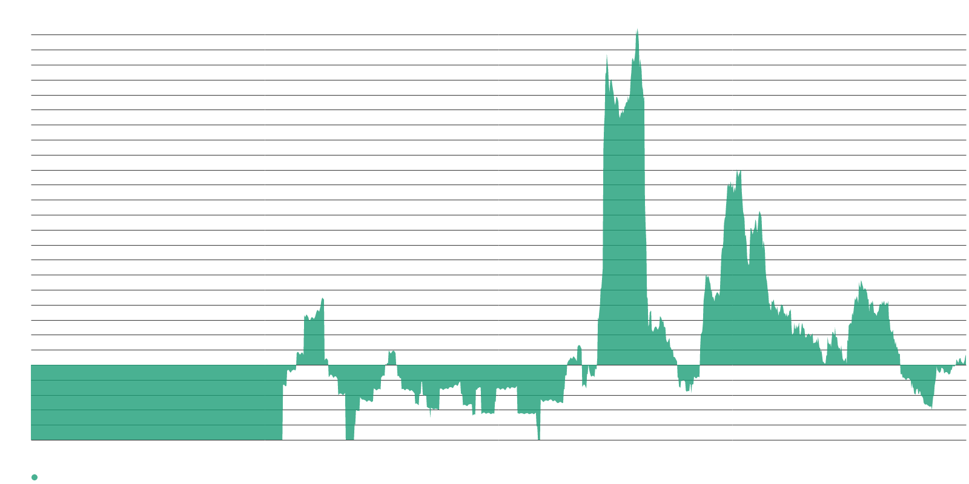
xAI registered its first meaningful move above norm as Grok 4.5 shipped.
EMERGING COMPETITIVE SIGNALS
13.7
Grok-or-xAI signature — first move above norm
+9.2
Week-over-week from 4.5
The field is widening. Grok 4.5 is now rolling out in GitHub Copilot for agentic coding workflows, and the signature tracking claims that the eventual AI winner has not been founded yet ticked up from near zero — aligned with coverage arguing the lead can now change by task, release cycle, or pricing model.
Displacement framings remain absent: language predicting AI will kill internet search and news organizations sits deeply negative. The competitive story this week is agents, cost per token, and open weights — not benchmarks and not disruption. With Anthropic's October listing window approaching, expect competitive standing and the capital-markets narrative to fuse into a single storyline this autumn.

Slide 15
Three storylines are converging into one as autumn approaches.
SYNTHESIS
Memory, not compute. The constraint narrative moved decisively from GPUs to DRAM, substations, and local resistance. This reframes AI capacity as a supply-chain and permitting problem, with timelines measured in years, not quarters.
Market risk, not tech disappointment. Skepticism surged in financial-collapse vocabulary while classic disillusionment framings stayed flat. The distinction between a valuation bubble and an earnings bubble is now carrying the argument, with $3 trillion spent against "very disappointing" adoption.
Price, not benchmarks. A full-scale token price war fragmented competitive coverage just as buyer skepticism peaked. Falling unit costs function as procurement leverage — and with Anthropic's listing approaching, the competitive and capital-markets stories are on a collision course.

Slide 16
What to watch in the weeks ahead.
LOOKING FORWARD
Anthropic's listing timeline. A confidential filing targets October at a valuation near $1 trillion. Whether buyer-skepticism density continues rising as the window opens will determine whether the listing narrative reads as validation or as a top signal.
Memory allocation decisions. Samsung's Q2 guidance that the shortage intensifies in 2027 sets up a supply-chain chokepoint. Watch whether frontier labs begin disclosing memory commitments the way they once disclosed GPU counts — the metric shift would confirm the narrative rotation.
Local resistance durability. Fifteen states weighing pauses and 100+ localities with approved moratoria make permitting the next structural constraint. If New York's executive-order moratorium survives legal challenge, expect other states to follow and the data-center-delay signature to climb further.

