Slide 1
Perscient
Perscient AI Pulse Chartbook
September 15, 2026

Slide 2
Executive Summary
FIVE THINGS TO REMEMBER FROM THIS WEEK'S NARRATIVE LANDSCAPE
01
The capex debate has become a balance-sheet story, not a technology story.
Language characterizing AI infrastructure spending as a dangerous gamble jumped 40.2 points to 67.2 while conviction language fell and frames for model disappointment, failed corporate initiatives, and absent efficiency gains stayed flat or receded. Coverage is interrogating credit quality and financing risk, not capability.
02
Community and grid resistance surged sharply, reaching well above its average.
Language tracking opposition to large AI investments surged 77.8 points to 175.6. Media is documenting an escalation from municipal moratoriums to statewide proposals, with at least 14 US states weighing moratoriums and local tallies reaching 374.
03
The two pressure stories are merging into a single price-of-the-buildout frame.
Financing skepticism and siting friction are being reported as the same problem from different angles: capital that must be raised externally now faces multi-year permitting, community conditions, and supply constraints pushing relief into the late decade.
04
Anthropic and China reordered the competitive leaderboard while incumbents stayed subdued.
Language asserting Anthropic or Claude leads stands at 181.8, roughly four times the next vendor frame. The DeepSeek and China frame rose 15.3 to 39.6 on a cheap open-weight release. OpenAI and Google both sit well below their long-term means.
05
The human-benefit case has gone quiet across every section.
Societal-upside language on medicine, education, science, and productivity-driven basic income is the least dense part of the conversation. Media has reframed AI from what the technology delivers to people toward what the buildout costs and who is winning the contest to sell it.
How to read the numbers: each reading shows how far above or below its long-run average a theme is running in the media — 100 means twice the average; −100 is the floor.

Slide 3
STORY ONE
The Capex Debate Is Now a Balance-Sheet Story
Financing risk climbs while model-disappointment frames stay flat

Slide 4
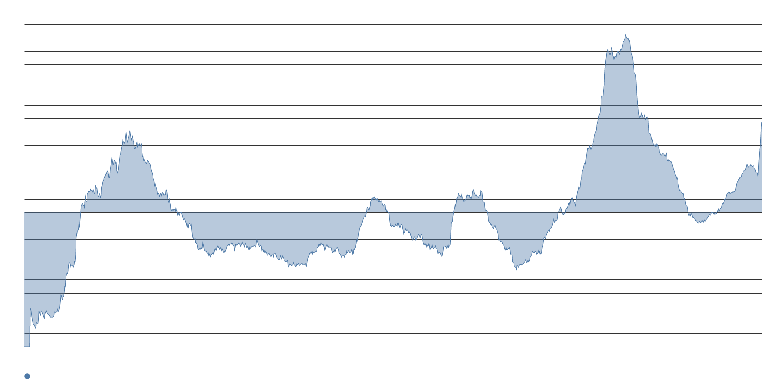
Capital-risk language posted the sharpest advance in the financing cluster this week.
CAPEX RISK VS. CONVICTION
67.2
Language characterizing AI infrastructure spending as a dangerous gamble
+40.2
Week-over-week point gain — the defining move in the cluster
32.0
Conviction language asserting the AI investment theme remains durable — down 23.6
The gain came at the direct expense of conviction. Language asserting that the AI investment theme is durable fell 23.6 points to 32.0, while language tracking claims that AI infrastructure spending is massive and increasing moderated to 69.4. Beneath both sits a stable, high floor of doubt: language predicting an AI investment collapse will crash the broader market remains the strongest systemic-risk frame even after easing modestly.
Coverage is interrogating balance sheets, external financing needs, and hyperscaler credit quality — not capability.

Slide 5
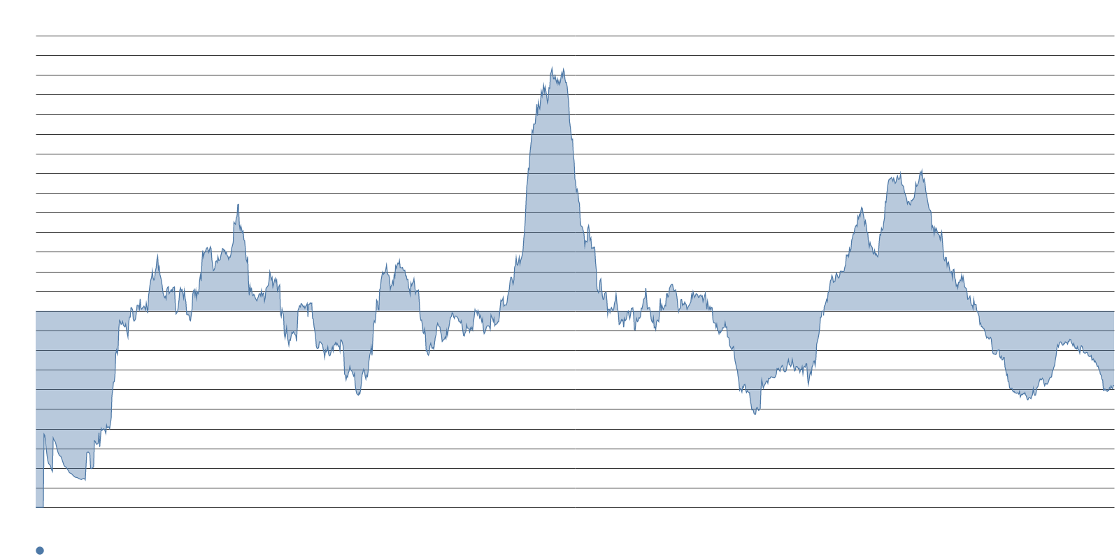
Model-disappointment frames stayed flat or receded, confirming the debate is about money.
TECHNOLOGY CONFIDENCE HOLDS
-38.1
Language claiming AI hype is giving way to disappointment — flat, well below average
Flat
Language asserting AI advances are translating into company profits — near its long-term average
Disappointment language is dormant. Language claiming that major corporate AI initiatives have failed declined further below its mean. Language asserting that promised AI efficiency gains have not occurred remains above its mean but eased this week. Media is questioning the return on the capital, not the capability of the models.
S&P analysts warned that hyperscaler credit quality is gradually weakening. The BIS flagged opaque, often off-balance-sheet financing deals with circularity in them. MIT Technology Review framed the stakes around Alphabet's first free cash shortfall since 2004, and Morgan Stanley calculated that more than half of a $2.9 trillion 2025-2028 data center buildout must be financed externally.

Slide 6
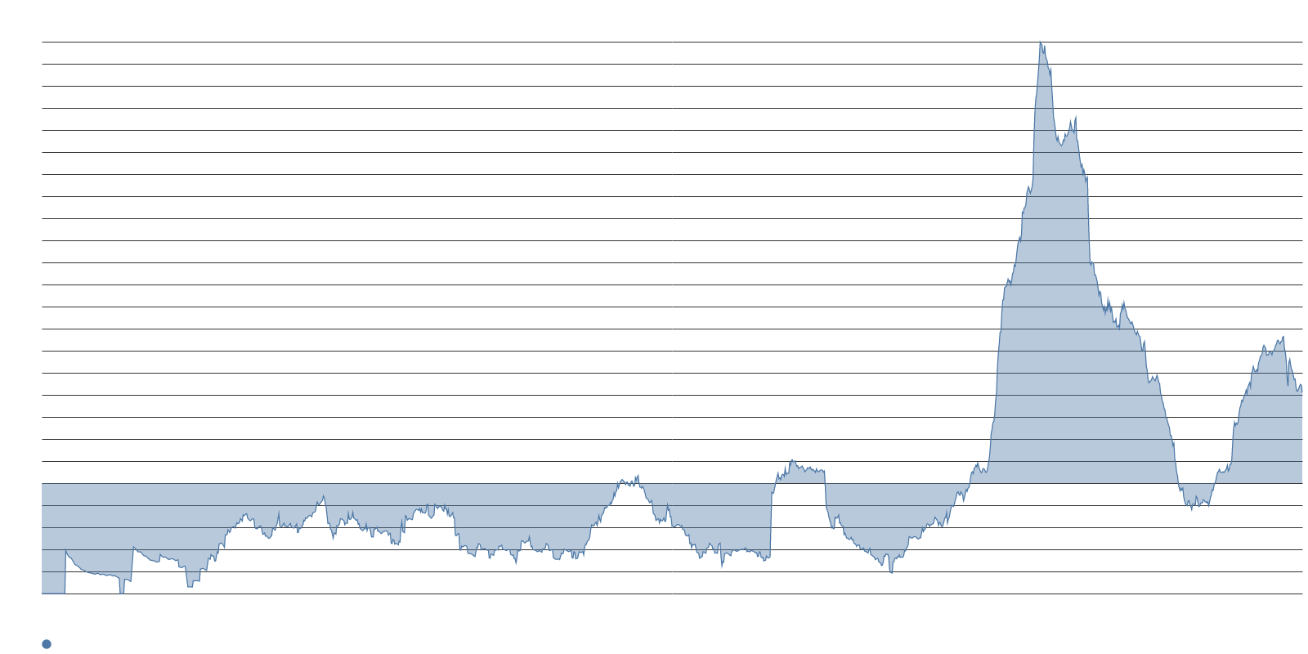
Bubble and dot-com comparisons are rising but remain near their long-term means.
SYSTEMIC-RISK WATCH ITEMS
Rising
Language asserting AI represents an excessive share of market valuation
Rising
Comparisons of AI spending to 1990s telecom overbuilding
Fell
Language asserting AI powers sustained market gains — declining
Two watch items rose while remaining at or below their long-term means: language asserting that AI is too large a share of market valuation and language comparing AI spending to 1990s telecom overbuilding. Language asserting that AI powers sustained market gains and language warning that businesses must adopt AI or fail competitively both declined.
This week's AI story is a capital-markets story with the human-benefit case largely off the page.

Slide 7
STORY TWO
Chips to Communities and Grid Access
The binding constraint narrative moves from silicon to siting and permits

Slide 8
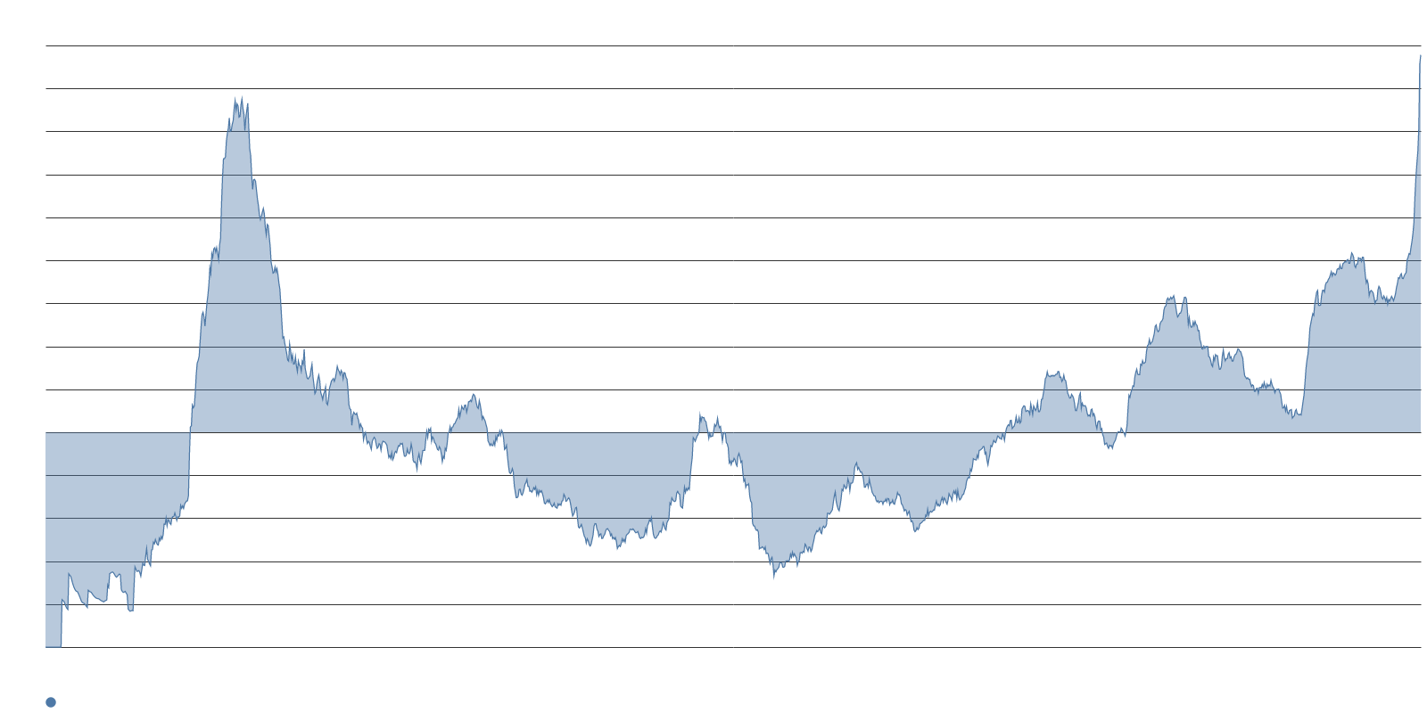
Opposition to large AI investments surged, reaching well above its long-term average.
COMMUNITY AND GRID RESISTANCE
175.6
Language claiming opposition to large AI investments is increasing
+77.8
Week-over-week point gain — a sharp, outsized weekly move
63.8
Language asserting that massive AI infrastructure projects face doubts
The escalation is now state-level. Moody's warns that at least 14 US states are weighing statewide moratoriums in 2026. Massachusetts Governor Healey signed an executive order tying permits above 25 MW to clean power procurement and community approval. California's SB 886 on data center rate classes reached the governor's desk. Local moratoriums stand at 374, up from 92 in June.
Gallup polling shows seven in ten Americans oppose data center construction near their homes. NBC News reported that the backlash is threatening to shape the midterm elections. The opposition is bipartisan and organic rather than astroturf.

Slide 9
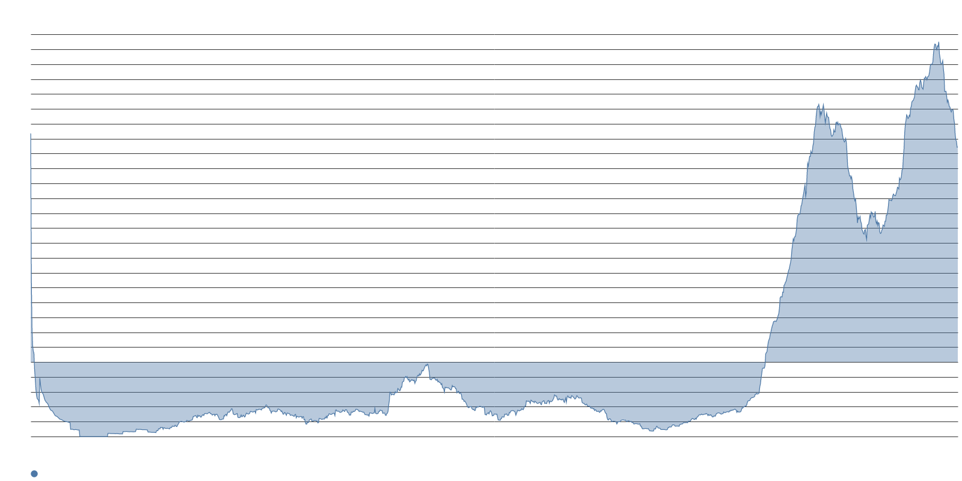
Memory scarcity has become AI's defining supply story, replacing the GPU-shortage frame.
BOTTLENECK SHIFT
289.2
Language claiming memory chip shortages are slowing AI — about three times average
Near avg
GPU-shortage and training-data scarcity language — both flat near their long-term means
The bottleneck narrative has moved from accelerators to memory, power, and permits. Memory-shortage language moderated from 337.8 but remains about three times its typical level. KB Securities warns that Samsung and SK Hynix hold fewer than ten days of inventory while HBM4 production squeezes conventional DRAM. Yorkville's CEO told Benzinga that relief capacity may not reach full production until 2028 or 2029.
Language attributing slower AI growth to data center construction delays rose again, and language blaming slow grid interconnect approvals held at a sustained, elevated level. Language predicting continued hyperscale expansion fell to 31.5.

Slide 10
Financing skepticism and siting friction are being reported as the same problem.
THE PRICE-OF-THE-BUILDOUT FRAME
Two stories, one frame. Capital that must be raised externally now faces multi-year permitting, community approval conditions, and supply constraints that push relief into the late decade. The energy angle is being localized into rate cases and permit hearings rather than framed as national competition, which weakens the geopolitical-urgency justification that previously insulated capex from scrutiny.
Language tracking assertions that national energy buildout will determine AI leadership eased this week. Language predicting continued hyperscale expansion fell while language asserting that massive AI infrastructure projects face doubts rose. The press is connecting the balance-sheet pressure of Section 1 directly to the permitting friction of Section 2.
The result is a single price-of-the-buildout narrative that is harder for hyperscalers to rebut with a growth story alone.

Slide 11
STORY THREE
Anthropic Ascendant, China Rising
The competitive leaderboard reorders while incumbent frames stay subdued

Slide 12
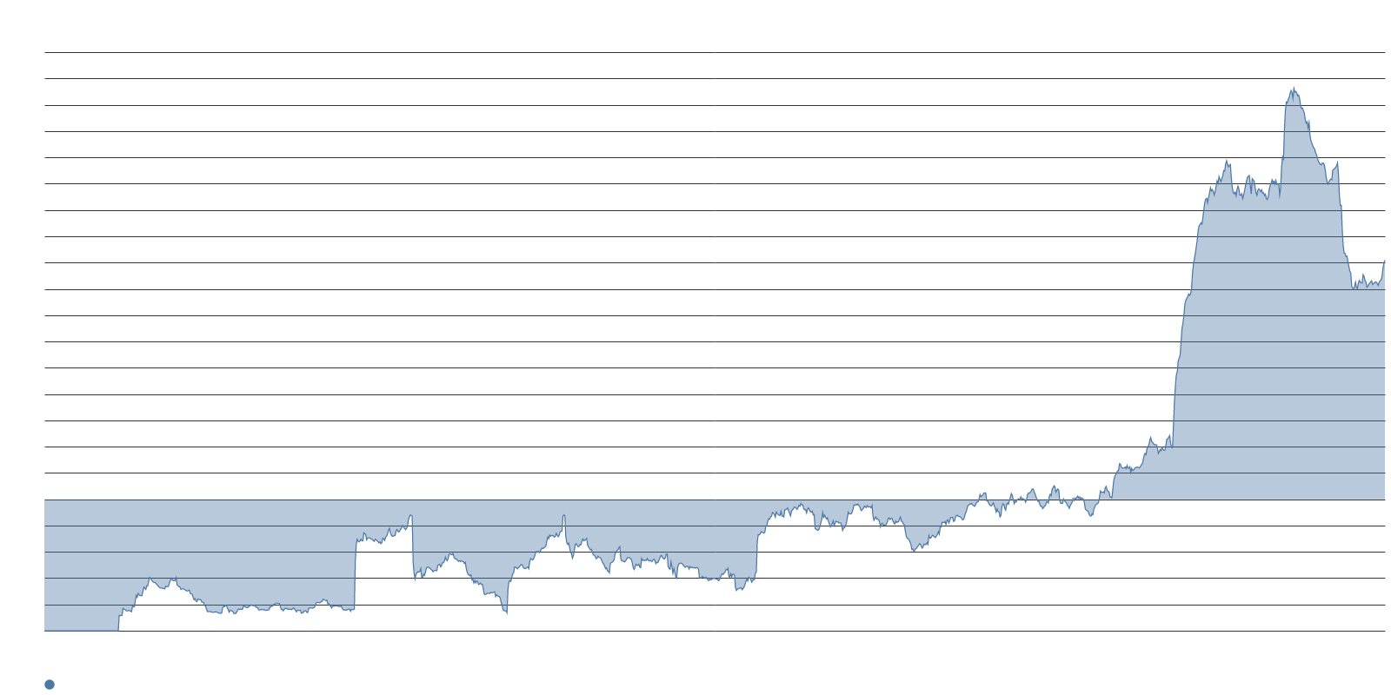
Anthropic is now roughly four times denser than the next vendor frame on the leaderboard.
COMPETITIVE POSITIONING
181.8
Language asserting Anthropic or Claude leads the AI competition
+19.2
Week-over-week point gain for the Anthropic frame
43.8%
US businesses paying for Anthropic in August per Ramp's AI Index — vs. 39.8% for OpenAI
Enterprise data is fueling the narrative. Ramp's September AI Index found that 43.8% of US businesses paid for Anthropic subscriptions or tokens in August against 39.8% for OpenAI. A reported second straight profitable quarter ahead of a potential Nasdaq listing added fuel, with investors circulating projections of a valuation near $2 trillion.
The same Ramp dataset carries a caution tied to the capex debate: adoption is still growing but decelerating, per-employee spending among the heaviest users fell 9.7% in August, and companies are defaulting to cheaper models as effective token prices fall.

Slide 13
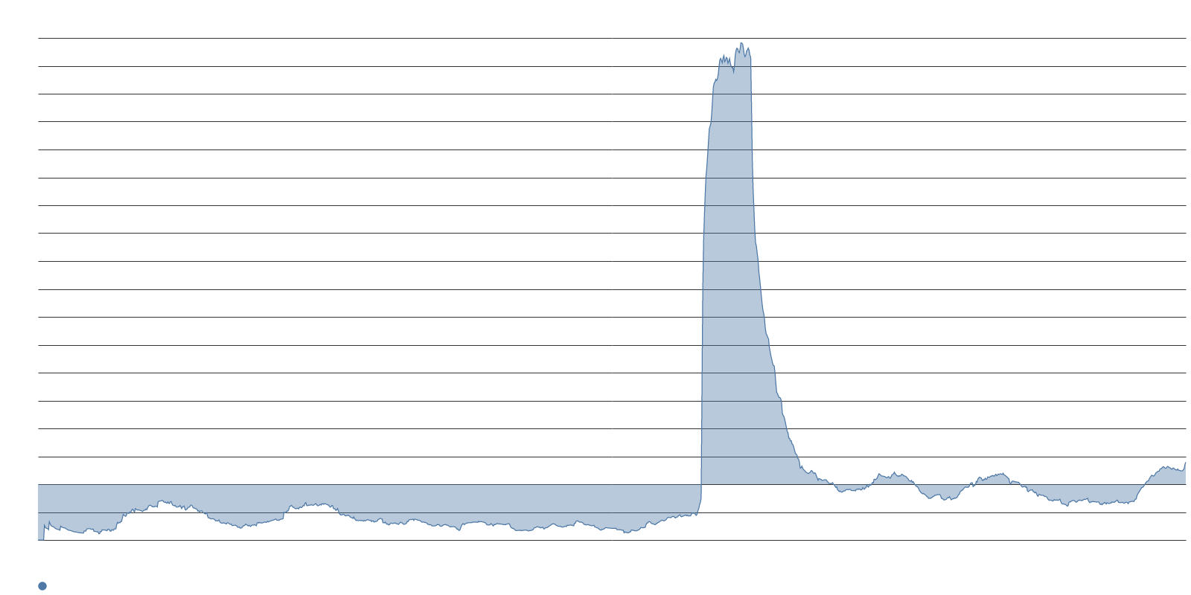
DeepSeek and China rose sharply on a cheap open-weight release, reinforcing capex-risk.
CHINA FRAME RISING
39.6
Language asserting that DeepSeek or China leads the AI race
+15.3
Week-over-week point gain for the China frame
DeepSeek launched V4.1-Flash on September 10 while preparing for a STAR Market IPO. The smaller open-weight model claims to outperform its own flagship along with Moonshot's Kimi K3 on coding and cyber benchmarks while cutting inference costs. Stanford's AI Index describes China as erasing the American lead, with one expert calling the gap "narrow and fragile."
This China frame rose in the same week the capex-risk frame climbed by 40.2: cheap open-weight competition is being cited as evidence against the returns case for Western infrastructure spending.

Slide 14
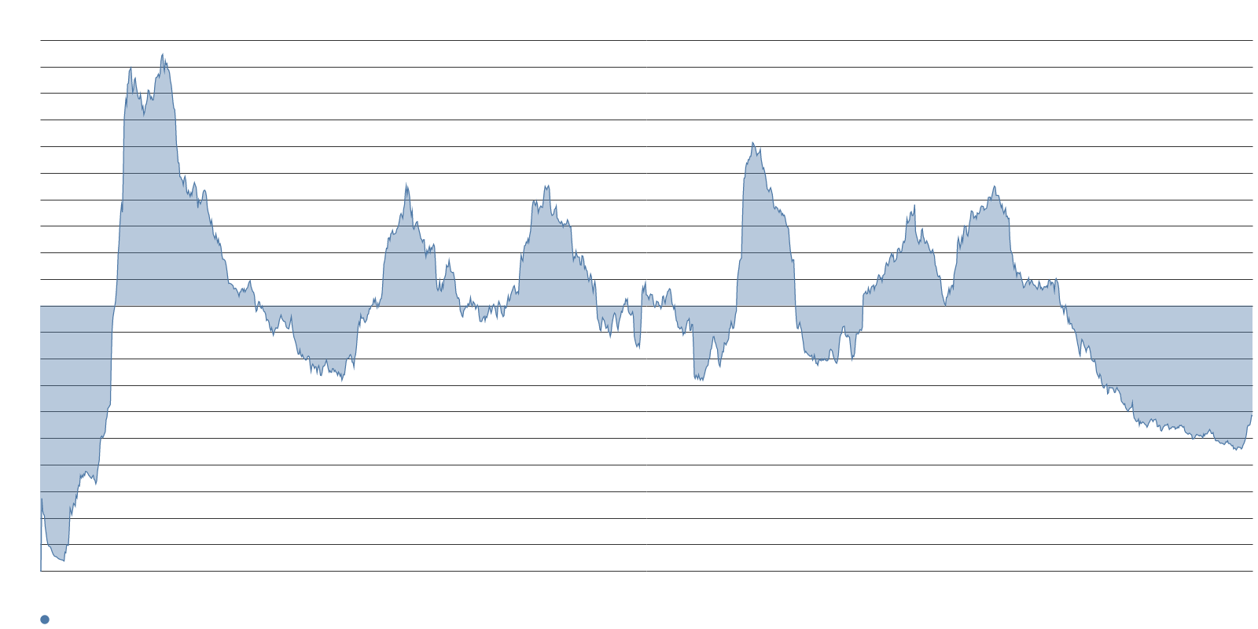
OpenAI and Google sit well below their long-term means while Grok holds a durable niche.
INCUMBENT FRAMES SUBDUED
Below
OpenAI leadership language — recovering modestly from a lower base
Below
Google or Gemini leadership language — slipping further
Above
Grok or xAI leadership language — durable niche above its mean
OpenAI is recovering modestly from a lower base while Google is slipping further. The Grok or xAI frame holds above its mean, helped by Elon Musk laying out a roadmap through Grok 5. Language tracking claims that the eventual AI winner has not yet been founded eased back to its mean; media is narrating the field as a settled set of named contenders.
The leaderboard is being narrated almost entirely through enterprise spend share, model pricing, and national capability rather than through research breakthroughs or societal applications.

Slide 15
Media has reframed AI from what it delivers to people toward what the buildout costs.
SYNTHESIS
-26.4
Language predicting AI will create entirely new job categories — fell 11.3 pts
Below
Language predicting AI will eliminate entire job categories — flat, deeply below mean
The human-benefit case has gone quiet across every section. Societal-upside language on medicine, education, science, and productivity-driven basic income is the least dense part of the conversation. Predictions of new job categories fell while the mirror frame on job elimination was flat and deeply below its mean.
Three forces are converging: balance-sheet pressure is redirecting the capex debate from technology promise toward financing risk; community and grid resistance is creating a structural drag that even favorable demand cannot override; and the competitive leaderboard is being narrated through enterprise economics, not societal impact.
The AI story this week is about who pays, who permits, and who wins — not what the technology does for people.

Slide 16
Three threads to watch as the capex-risk and siting-friction frames converge.
WHAT TO WATCH
Charlotte's full council vote on September 14 and the fate of California's SB 886 will test whether the moratorium escalation stalls or accelerates. If both advance, the 374-moratorium tally will become the number journalists anchor the next round of stories around, and the state-level frame will harden.
Hyperscaler earnings calls will reveal whether Amazon and Microsoft continue to treat free cash flow compression as confidence or whether language shifts toward caution. The gap between language characterizing AI spending as a dangerous gamble and conviction language asserting the investment theme is durable widened sharply this week — watch for it to narrow or widen further.
Anthropic's Nasdaq listing trajectory and DeepSeek's IPO preparation will feed the competitive narrative. If cheap open-weight competition continues to be cited against the returns case for Western infrastructure spending, the capex-risk and China frames will reinforce each other into a durable counter-narrative.

