Slide 1
Perscient
AI Pulse Chartbook
September 8, 2026

Slide 2
Executive Summary
FIVE THINGS TO REMEMBER FROM THIS WEEK'S NARRATIVE LANDSCAPE
01
The bottleneck story has moved from logic to memory.
Language asserting that memory chip shortages are slowing AI growth is the densest reading in the set at 345.9, while comparable GPU-shortage language sits near baseline at 4.2. Coverage has consolidated around DRAM, HBM4 allocation, and sub-10-day finished inventories at Samsung and SK Hynix.
02
Physical-world constraints are displacing financial-risk constraints.
Language on data center construction delays rose to 158.7 and interconnection approval delays reached 117.9, driven by 90-to-130-week equipment lead times and waits of up to seven years in Northern Virginia.
03
Crash framing gave up ground, but the ROI test grew more demanding.
Language predicting an AI crash fell 23.3 points to 89.8, and telecom-overbuild analogies dropped below average. Yet business doubt about large AI spending remains elevated at 84.2, and only 5% to 8% of enterprises report at-scale returns.
04
Long-horizon utopian promises thinned while near-term durability claims held.
Language connecting AI to productivity gains and UBI posted one of the week's largest declines, while language asserting the AI investment theme remains durable stayed elevated at 57.5. Coverage is narrowing its time horizon.
05
Permission to build is emerging as the competitive frame.
Language claiming opposition to large AI investments is growing rose 16.4 points to 97.9, fed by more than 500 local bans and pauses. Anthropic retains the densest race-leadership reading at 164.9, while xAI posted the set's largest weekly increase.
How to read the numbers: each reading shows how far above or below its long-run average a theme is running in the media — 100 means twice the average; −100 is the floor.

Slide 3
STORY ONE
Memory, Not Compute, Now Anchors the Supply Story
RAM shortages and physical bottlenecks are shaping AI's next phase

Slide 4
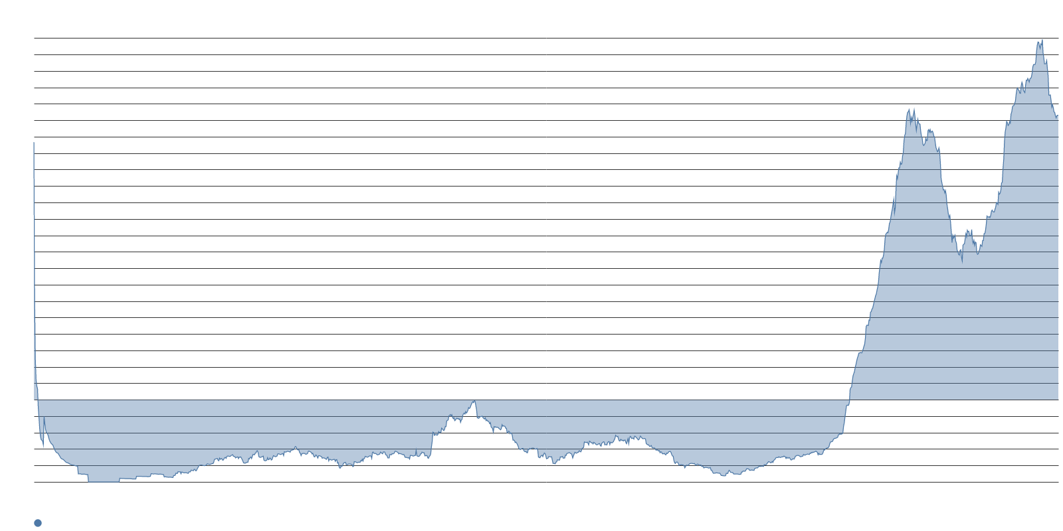
Memory chip scarcity is now the densest supply-constraint theme in the entire set.
MEMORY VERSUS GPU CONSTRAINTS
345.9
Language asserting memory shortages are slowing AI — the week's densest reading
4.2
Comparable GPU-shortage language — near baseline and drifting lower
~340pt
Gap between memory and GPU constraint language
The chip-shortage conversation has migrated almost entirely from logic to memory. Language asserting that unexpected memory shortages are slowing AI growth reads about three-and-a-half times its average, while GPU-shortage language sits near its long-run norm.
The supply narrative now has a multi-year horizon rather than a quarterly one — coverage has consolidated around DRAM, HBM4 allocation, and wafer reallocation that IDC characterizes as potentially permanent.

Slide 5
DRAM prices are projected to rise more than 400% over three years as inventories shrink to days.
THE MEMORY SUPPLY CRUNCH IN NUMBERS
400%+
Projected DRAM price rise from start of 2024 through end of 2026 — J.P. Morgan
<10d
Finished DRAM inventory at Samsung and SK Hynix — KB Securities
~70%
Share of high-end DRAM that AI data centers may consume in 2026
Samsung and SK Hynix together control roughly 64% of worldwide DRAM revenue but now hold fewer than 10 days of finished inventory. KB Securities warned that the volume available for sale itself could be depleted next year.
Producing one HBM4 module consumes roughly three times the wafer capacity of conventional DRAM. TrendForce's Avril Wu suggests new production will not meaningfully change global supply until 2028, and the major producers are already selling 2027 and 2028 capacity.

Slide 6
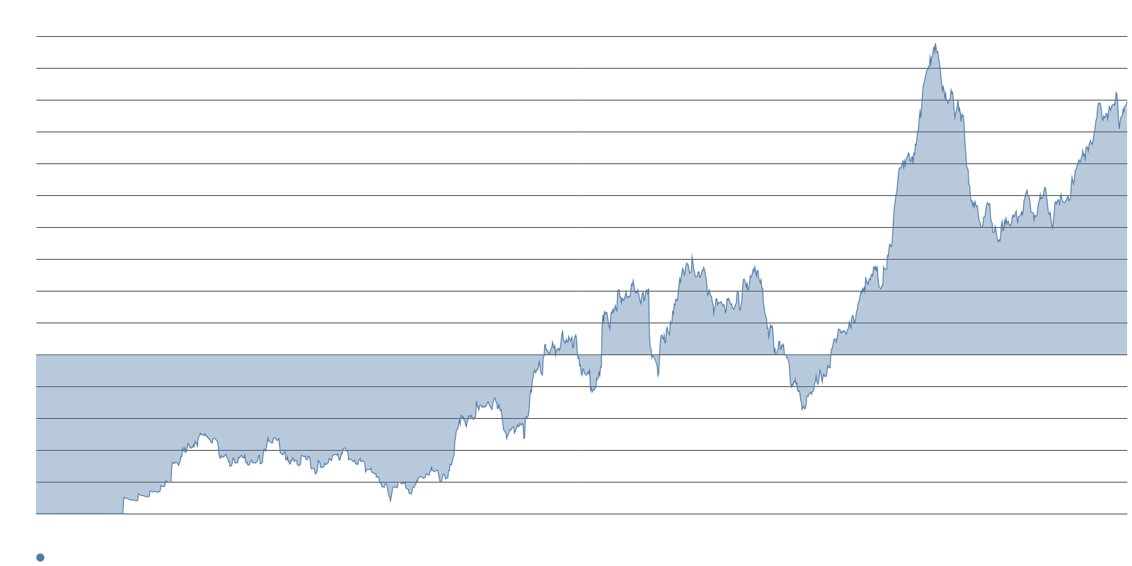
Data center delays and grid bottlenecks now rank as the second-tier constraint story.
PHYSICAL INFRASTRUCTURE LIMITS
158.7
Language on data center build delays — up 9.2, well above average
117.9
Language blaming slow grid interconnection approvals — elevated
78.8
Language asserting AI infrastructure spending is massive — flat on the week
Equipment, not permits, is the proximate driver: power transformers, breakers, and large conductor now face 90-to-130-week lead times. The IEA estimates that roughly 20% of planned global data center projects face significant delays from power access, with waits reaching up to seven years in Northern Virginia.
LBNL's latest Queued Up edition counted about 8,200 active projects at end-2025, a 10% year-over-year decrease in total active queue volume. Memory's share of AI infrastructure spend is projected to rise from 14% in 2025 toward 57% in 2027.

Slide 7
STORY TWO
Crash Framing Recedes, but the ROI Test Hardens
Markets have traded the bubble-pop storyline for a deferral storyline

Slide 8
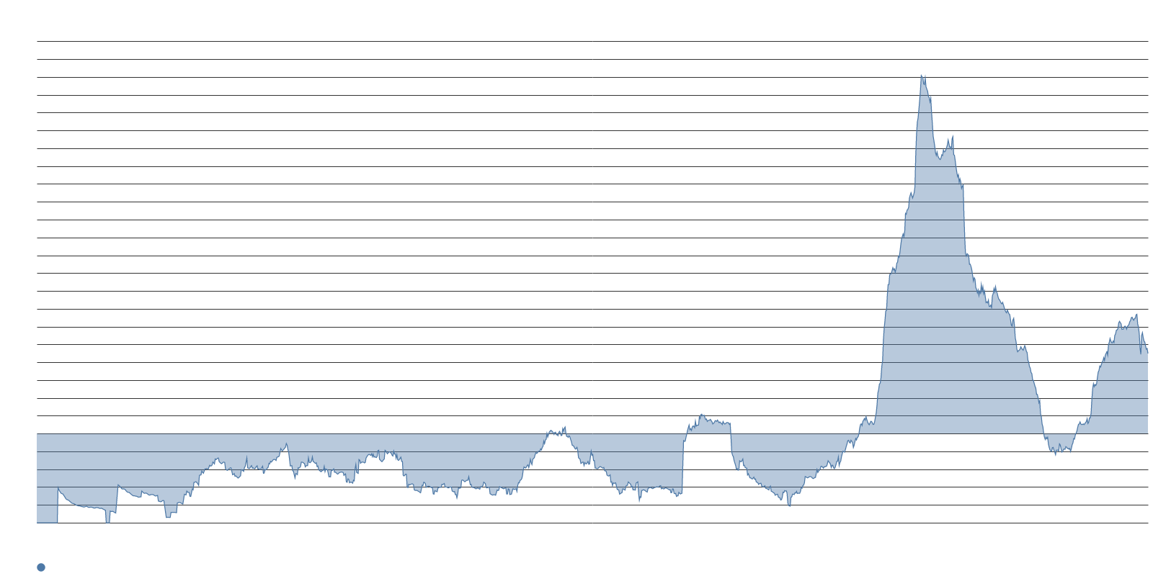
AI bubble language posted a sharp single-week decline, but the reading remains well above average.
CRASH FRAMING GIVES GROUND
89.8
Language predicting an AI crash will bring down the market — down 23.3 pts
-23.3
Week-over-week point change — the sharpest weekly decline in the set
<Avg
Telecom-overbuild analogy language — fell below average
The 1999-redux storyline lost airtime this week: language comparing AI spending to fiber-era overbuilding fell to below-average territory, and language claiming AI is an excessive portion of market value also slipped. Even after its decline, crash-prediction language remains well above its long-run mean.
Outlets like CEPR continue running a weekly AI Bubble Monitor, and bearish voices argue the boom is entering a dangerous phase as spending approaches $1 trillion.

Slide 9
Only 5% to 8% of enterprises report at-scale AI returns, yet just 6% would cut budgets.
BUYER SCRUTINY STAYS ELEVATED
84.2
Language asserting businesses increasingly doubt large AI spending — eased but elevated
27.5
Language asserting promised AI efficiency gains have not materialized — above average
42%
Share of companies that abandoned most AI projects in 2025 — S&P Global
$890B
Recent tech drawdown — framed as the market demanding an ROI conversation
The pattern is deferral, not cancellation. Forrester expects enterprises to push 25% of planned AI spend into 2027, even as Gartner projects enterprise AI application spending to nearly triple to $270 billion in 2026. A separate Gartner survey found just 22% of organizations have successfully scaled AI, yet 85% of functional leaders still plan to raise spending.
Anthropic's reported first operating profit in frontier AI has bulls arguing that the capex is funded by demand, not hope — but skeptics counter that across 919 earnings calls at large US financial firms, only one company quantified a realized dollar return from AI.

Slide 10
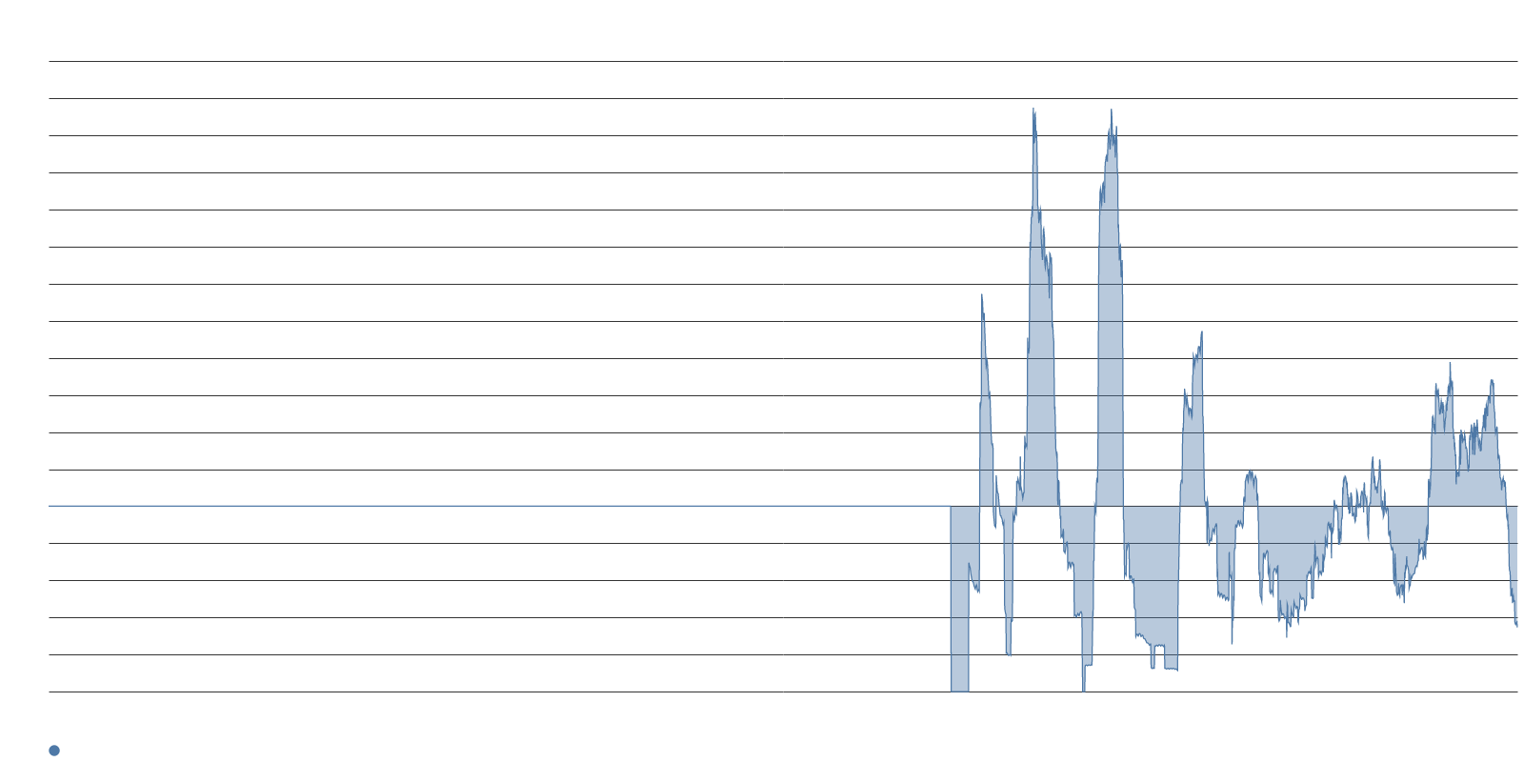
Long-horizon promises thinned while near-term durability claims held firm.
TIME HORIZON NARROWING
57.5
Language asserting the AI investment theme remains durable — eased but elevated
<Avg
Language connecting AI to productivity gains and UBI — sharp decline this week
23x
S&P 500 forward earnings multiple — Magnificent 7 at roughly one-third of index value
Language tracking multi-decade supercycle predictions also weakened, while language warning that non-adopters will be left behind sat flat below average. Coverage is narrowing its time horizon: fewer civilizational payoffs, more scrutiny of who can show a realized dollar of return.
The S&P 500 has averaged a 1.1% September decline since 1928, with megacap AI concentration cited as a possible amplifier. Watch whether the bubble language decline reverses into Q3 hyperscaler earnings.

Slide 11
STORY THREE
Permission to Build Becomes the Competitive Frame
Local backlash, energy nationalism, and a reshuffled leaderboard

Slide 12
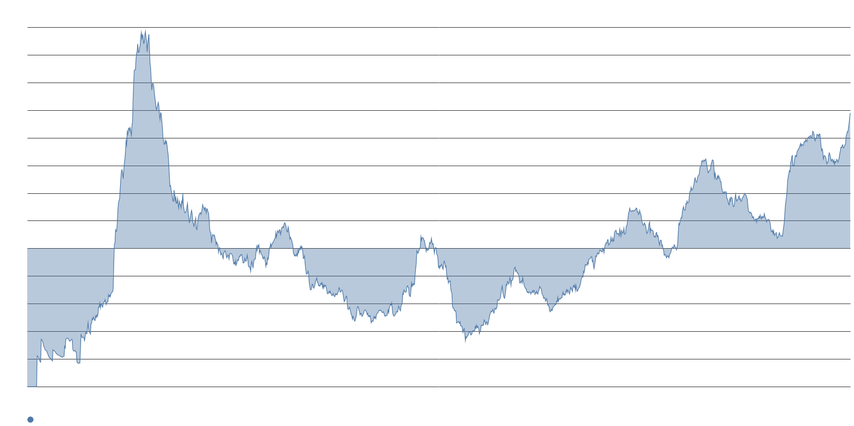
Opposition to large AI capital projects posted one of the week's largest gains.
THE LOCAL BACKLASH STORY
97.9
Language claiming opposition to large AI investments is growing — up 16.4 pts
500+
Local bans and pauses on data centers across the U.S. as of mid-2026
5-0
Mendocino County vote adopting a 45-day urgency ordinance barring new data centers
Mendocino County's September 1 ordinance adds to a wave: Ohio's Miamisburg City Council voted 6-0 for a nine-month moratorium, New York's Executive Order 62 covers DEC permits for facilities of 50 MW or more, and Texas has effectively frozen new grid connections while the PUC and ERCOT audit roughly 200 GW of interconnection requests.
Opposition is not winning uniformly — Indiantown's Village Council rejected a proposed pause 4-1 in early September — but Brookings observes that citizen opposition cuts across state and party lines.

Slide 13
Energy infrastructure, not model capability, is carrying the geopolitical narrative.
CAPACITY VERSUS CAPABILITY
55.6
Language asserting energy infrastructure will decide AI leadership — up 7.4 pts
Flat
Language asserting DeepSeek or China leads the AI competition — unchanged
~$295B
China's reported five-year AI data center investment plan — about 2 trillion yuan
The Diplomat argues that governments focusing mainly on semiconductor fabrication may be chasing past advantages instead of future ones, citing China's plan for a nationwide network of interconnected AI data centers. BloombergNEF estimates China will add more than six times as much generation capacity as the U.S. over the next five years.
Country-capacity framing is rising while claims of Chinese model leadership are not — the geopolitical narrative has shifted from who builds the best model to who builds the most power.

Slide 14
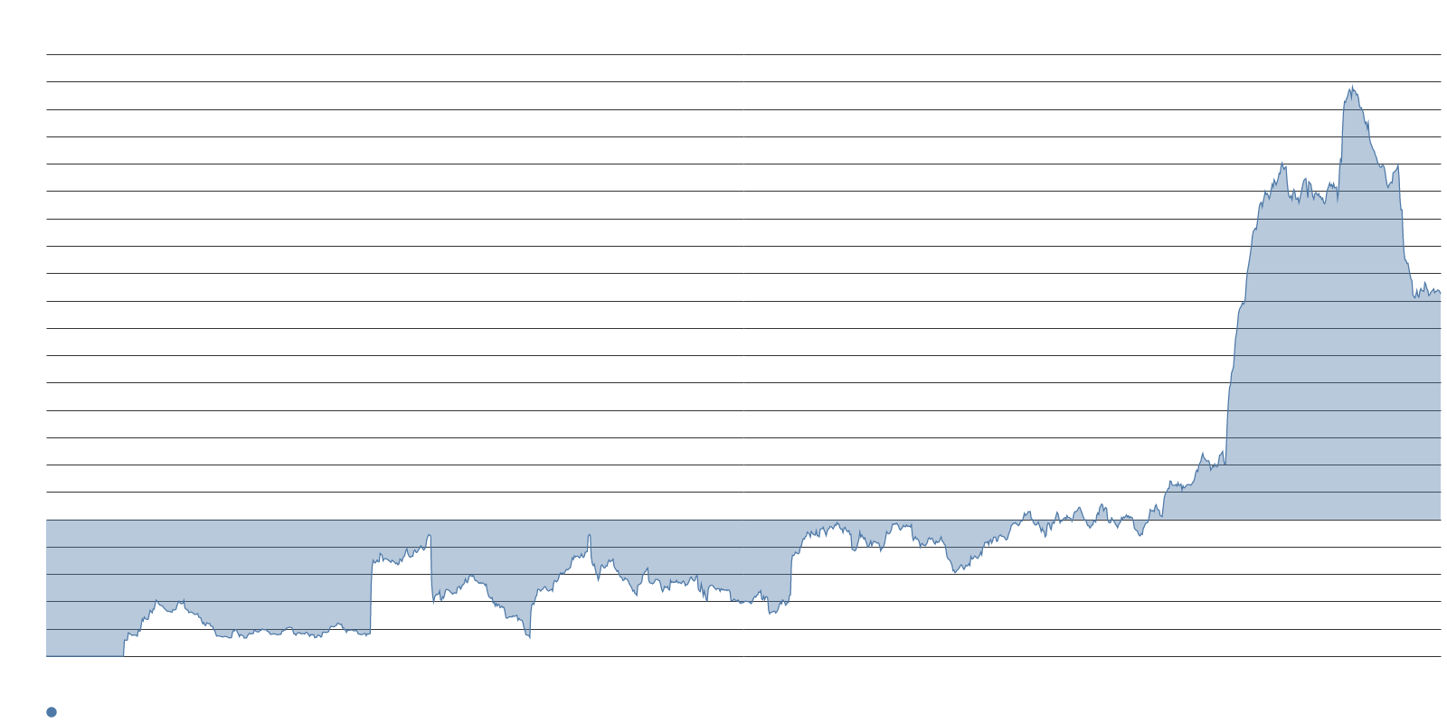
Anthropic holds the densest race-leadership reading while xAI posted the set's largest weekly gain.
CORPORATE LEADERBOARD RESHUFFLING
164.9
Language asserting Anthropic or Claude leads the AI race — the strongest leadership reading
+18.1
Weekly increase in language asserting xAI or Grok leads — to 25.1
<Avg
OpenAI leadership language — below average despite its September 2 Astra launch
Anthropic's reading is consistent with third-party estimates placing it at roughly 40% of enterprise LLM API spend versus OpenAI's 27%. The xAI increase plausibly reflects Grok Bot's enterprise launch with new access, network, and audit controls.
OpenAI's leadership language remains below average despite Astra's release and claims of leapfrogging Anthropic. Google's reading was flat. Language claiming the eventual AI winner has not been founded yet ticked up modestly.

Slide 15
The week's coverage argues that the binding limits on AI are equipment, wafers, and electrons.
SYNTHESIS
Three storylines converged this week. The memory wall replaced GPUs as the supply-side headline, with sub-10-day inventories and a wafer reallocation IDC calls potentially permanent. Crash framing lost airtime, but the ROI test hardened: enterprises are deferring, not canceling, and the market is demanding proof of realized returns before extending the AI premium.
Permission to build emerged as the frame that ties infrastructure and geopolitics together. More than 500 local bans, multi-year grid queues, and rising energy-nationalism claims all point to the same conclusion: the race is no longer about who trains the best model — it is about who can physically construct the capacity to run it.
The shift from financial risk to physical constraint is the week's defining feature, and it reframes the investment question from whether the money will be spent to whether the infrastructure can absorb it.

Slide 16
Four threads to track heading into Q3 earnings season.
WHAT TO WATCH
Memory cost pass-through. KB Securities projects memory's share of AI infrastructure spend rising from 14% in 2025 toward 57% in 2027. Watch whether hyperscalers begin renegotiating supply commitments as DRAM prices extend their multi-year climb.
Bubble language reversal. Crash-prediction language posted a sharp decline this week but remains well above its long-run mean. Q3 hyperscaler earnings will test whether the drop sticks or reverses — the Magnificent 7 now represent roughly one-third of S&P 500 value.
Local siting battles. September votes are queued in Spartanburg County, Loudoun County, Lubbock, and Pulaski County. Each outcome shapes the permitting environment for 2027 capacity additions.
The Anthropic-xAI gap. Anthropic's leadership reading at about two-and-a-half times its average towers over the field, but xAI posted the week's largest leadership gain. Enterprise adoption metrics in the next quarter will test whether that momentum translates.

