Slide 1
Perscient
AI Pulse Chartbook
August 25, 2026

Slide 2
Executive Summary
FIVE THINGS TO REMEMBER FROM THIS WEEK'S NARRATIVE LANDSCAPE
01
The bottleneck story has migrated from silicon to everything around it.
Language asserting that memory chip shortages are slowing AI growth remains the densest reading in the set at 409.8. GPU-scarcity language has receded to ordinary levels. Reporters now reach for DRAM pricing, interconnect queues, and construction schedules — not model capability — to explain delayed AI timelines.
02
Texas turned a permitting decision into a national narrative hinge.
Governor Abbott's audit directive and ERCOT's delayed Batch Zero review simultaneously drove up language about grid-interconnect and construction delays alongside language about growing resistance. Physical constraint and political consent are no longer separate storylines; the queue itself has become the venue where local opposition is expressed.
03
Spending guidance climbs while the justification thins.
Language describing massive infrastructure spending sits well above its mean alongside language predicting an investment collapse that crashes the broader market, now the second-densest frame tracked. Language connecting AI to corporate bottom lines and non-adopter risk both sit below average. Capex is being defended on near-term demand alone.
04
The bubble case is being argued in macro terms, not hype-cycle terms.
Comparisons to 1990s telecom overbuild and trough-of-disillusionment language have faded back toward their averages, displaced by valuation and systemic-risk vocabulary drawn from the ECB blog, fund-manager credit-event warnings, and MIT's findings on enterprise pilots.
05
Brand attention concentrates while the public-benefit case goes silent.
Language asserting Anthropic's leadership holds far above equivalent frames for rivals, and Grok-leadership language posted a steep weekly drop despite a new model release. Every benefit-framing measure — healthcare, education, science — sits below its long-term mean. No one is supplying the legitimacy story that continued build-out would require.
How to read the numbers: each reading shows how far above or below its long-run average a theme is running in the media — 100 means twice the average; −100 is the floor.

Slide 3
STORY ONE
Memory, Electrons, and Data
The bottleneck narrative shifts from silicon to infrastructure inputs and training scarcity

Slide 4
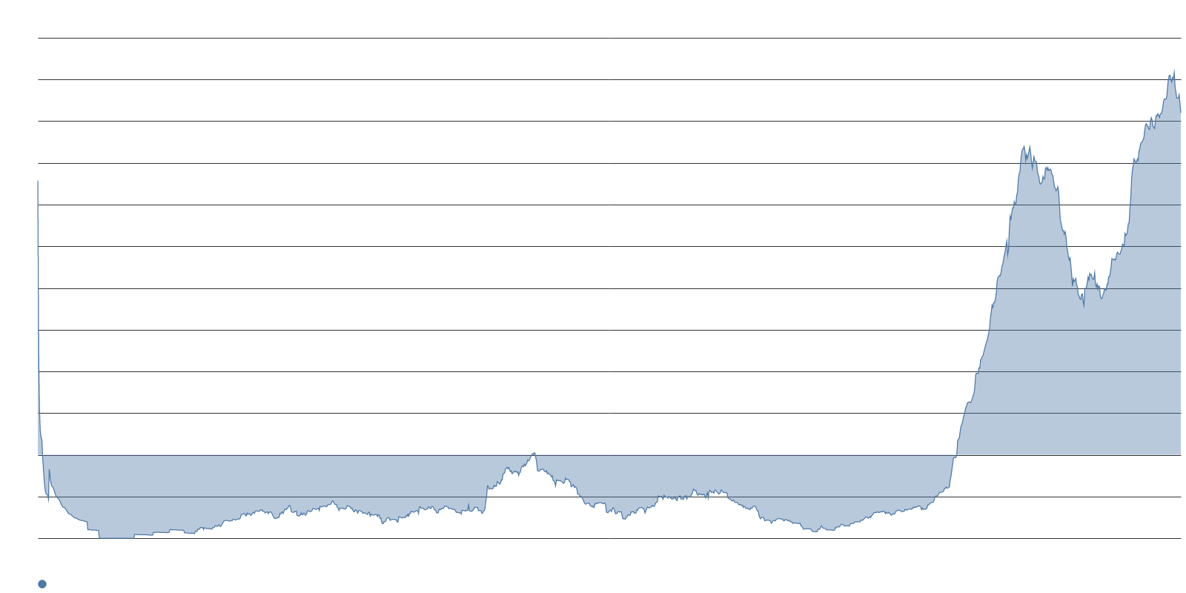
Memory scarcity has become AI's defining supply story.
SUPPLY CONSTRAINTS — MEMORY DOMINATES
409.8
Language asserting memory chip shortages are slowing AI — the densest reading in the set
-31.6
Week-over-week point change — easing but still roughly four times its average
$1.6T
Gartner's projected semiconductor revenue for 2026, up from $809B in 2025
DRAM and NAND revenue are each expected to roughly triple or quadruple, and memory is passing non-memory chips in total revenue for the first time. Samsung has warned the crunch will likely deepen next year and persist through 2028. J.P. Morgan estimates DRAM prices will have risen more than 400% from early 2024 to end of 2026.
Bloomberg reporting indicates that servers built around Nvidia's Vera Rubin and Grace Blackwell chips will cost more than 15% more in many cases, with contract manufacturers already notifying Microsoft, Google, and Oracle. IDC frames the shortage as structural rather than cyclical, with 2026 DRAM supply growth of just 16% as manufacturers pivot cleanroom space toward enterprise-grade components in a zero-sum allocation.

Slide 5
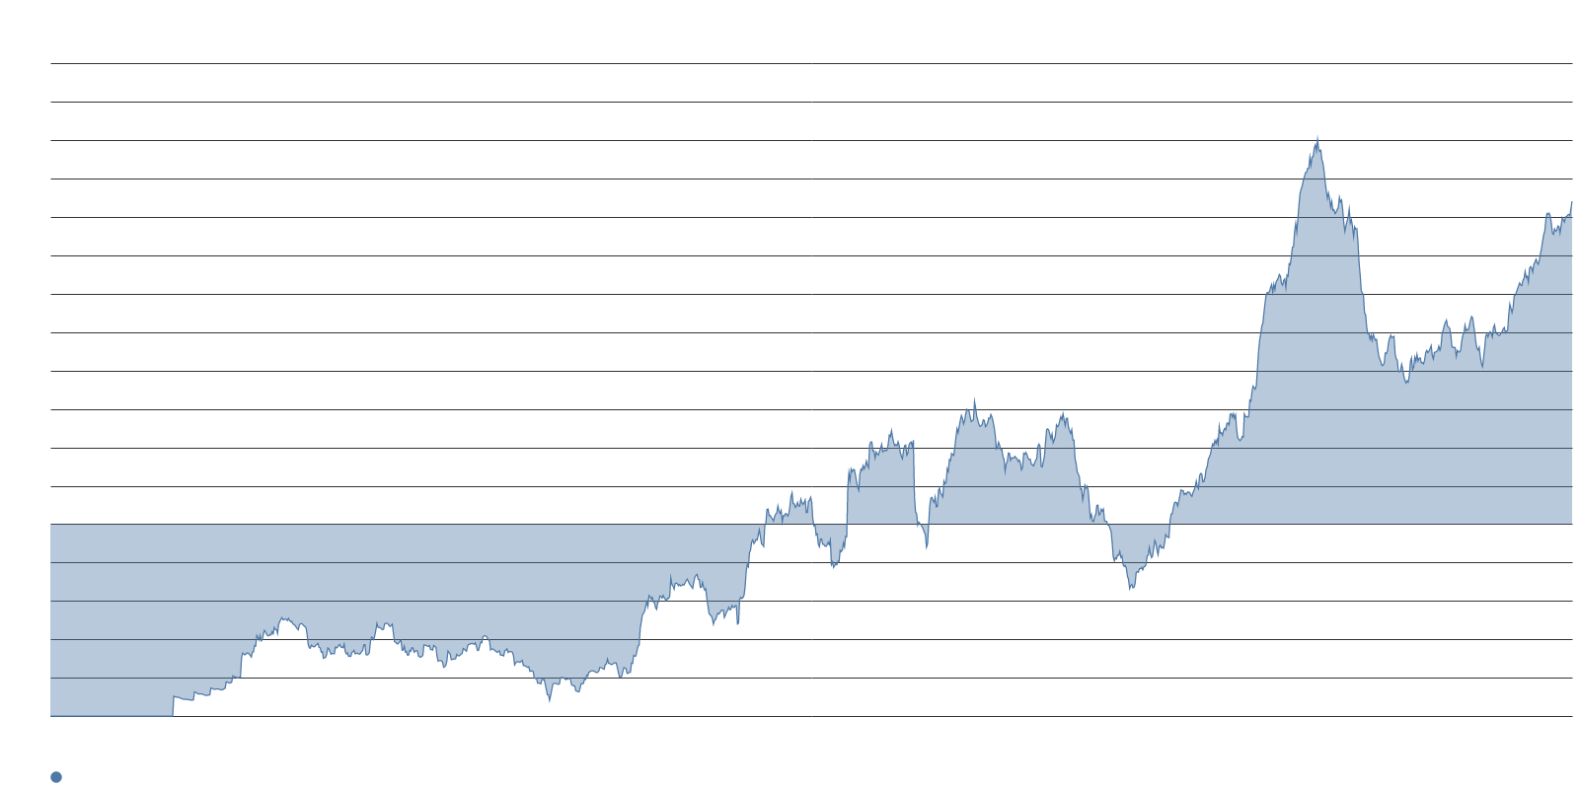
GPU scarcity has ceded narrative space to construction and grid delays.
INFRASTRUCTURE BOTTLENECKS — GRID AND CONSTRUCTION
168.2
Language blaming data center construction delays for slower AI growth
+10.8
Weekly rise in construction-delay language
154.3
Language blaming slow grid interconnect approvals for slower AI growth
49.8GW
U.S. data center capacity at risk of delay per BNEF
Language blaming GPU shortages for slower AI growth sits essentially at its long-term mean, while construction-delay and grid-interconnect language both climbed sharply. The proximate driver is Texas, where Governor Abbott's directive that regulators audit all data center projects led ERCOT to delay its Batch Zero review until mid-December.
BNEF estimates the Texas pause puts about 20% of the total U.S. data center pipeline at risk of delay, affecting almost 49.8 GW with potential revenue losses reaching $8 billion by Q1 2027.

Slide 6
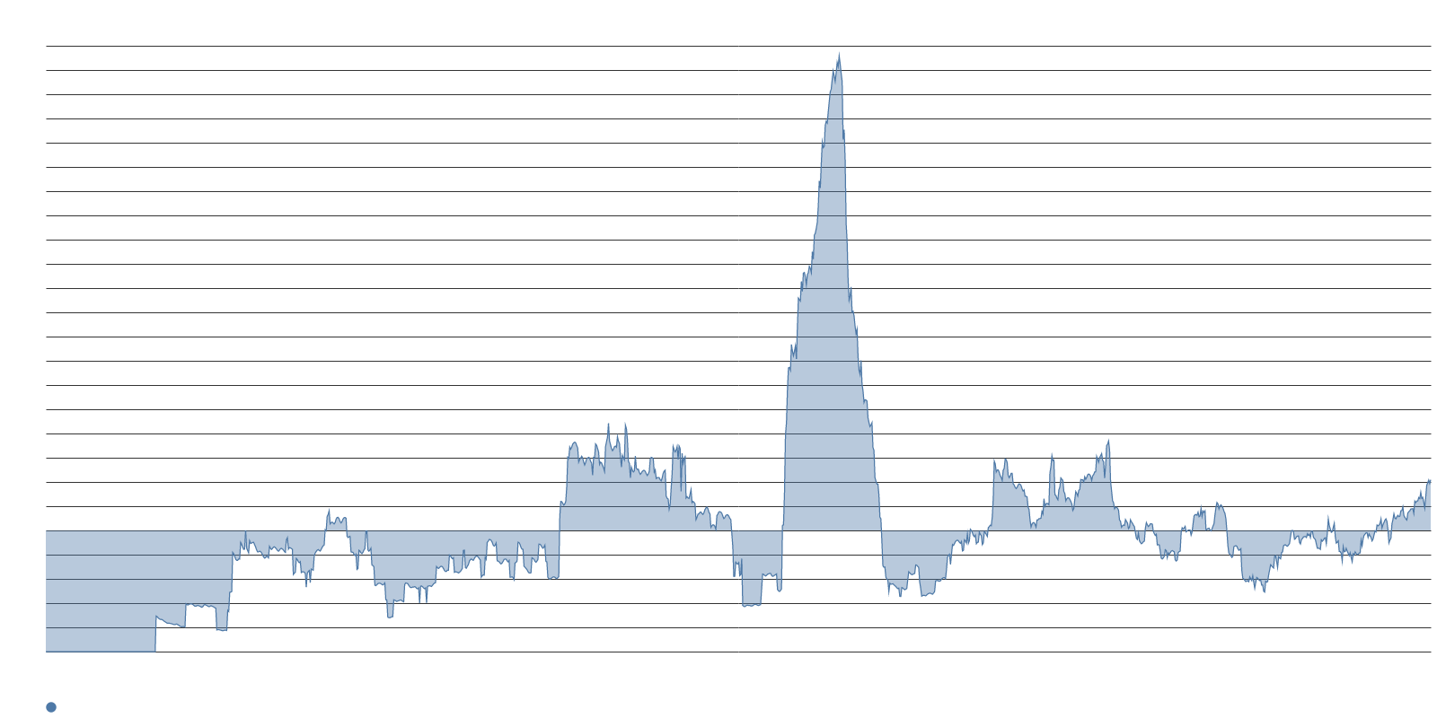
Training data scarcity surged into the conversation with a concrete price tag.
DATA SCARCITY — THE NEWEST CONSTRAINT
41.8
Language asserting scarce training data is slowing AI growth
+18.5
Point increase this week — the sharpest single weekly gain across all measures
Coverage of Google's winning $10 million bid for defunct Spirit Airlines' de-identified corporate data — outbidding Mercor at $7.5 million — gave the data-scarcity frame a vivid price signal. Forbes described hundreds of millions of employee emails, Teams messages, and operational records changing hands because labs that exhausted the public internet turned to enterprise archives.
Language arguing that national energy build-out will determine the AI winner declined this week as the conversation migrated from country-versus-country capacity competition toward domestic queue mechanics, permitting, and audits. Journalists explaining slipped AI timelines are reaching for schedule risk and input cost, not model capability.

Slide 7
STORY TWO
Capital Without Conviction
Spending guidance keeps climbing while the payoff case gets thinner

Slide 8
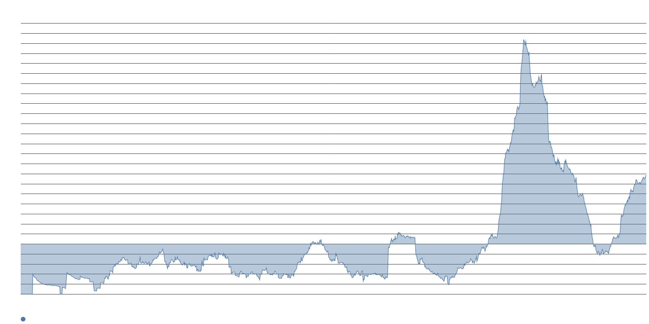
The crash-risk frame is now the second-densest reading in the file.
BUBBLE LANGUAGE — MACRO, NOT HYPE CYCLE
137.3
Language predicting an AI investment collapse that crashes the overall market
+4.7
Week-over-week point rise — steady accumulation, not a spike
€440B
Euro area household exposure to the Magnificent Seven per ECB blog economists
Five economists published on the ECB's website that research on past technological revolutions points to a worrisome conclusion: "a correction of current stock market valuations is likely," with severe potential consequences for the euro area given households' roughly €440 billion exposure to the Magnificent Seven. Reuters emphasized that even if the technology succeeds, stocks may still fall because markets' profit-growth bets are excessively optimistic.
Comparisons to 1990s telecom overbuild and trough-of-disillusionment language have both faded back toward or below their averages. The skeptical frame has moved from technology commentary into financial-stability commentary — valuation and systemic-risk vocabulary has displaced hype-cycle vocabulary.

Slide 9
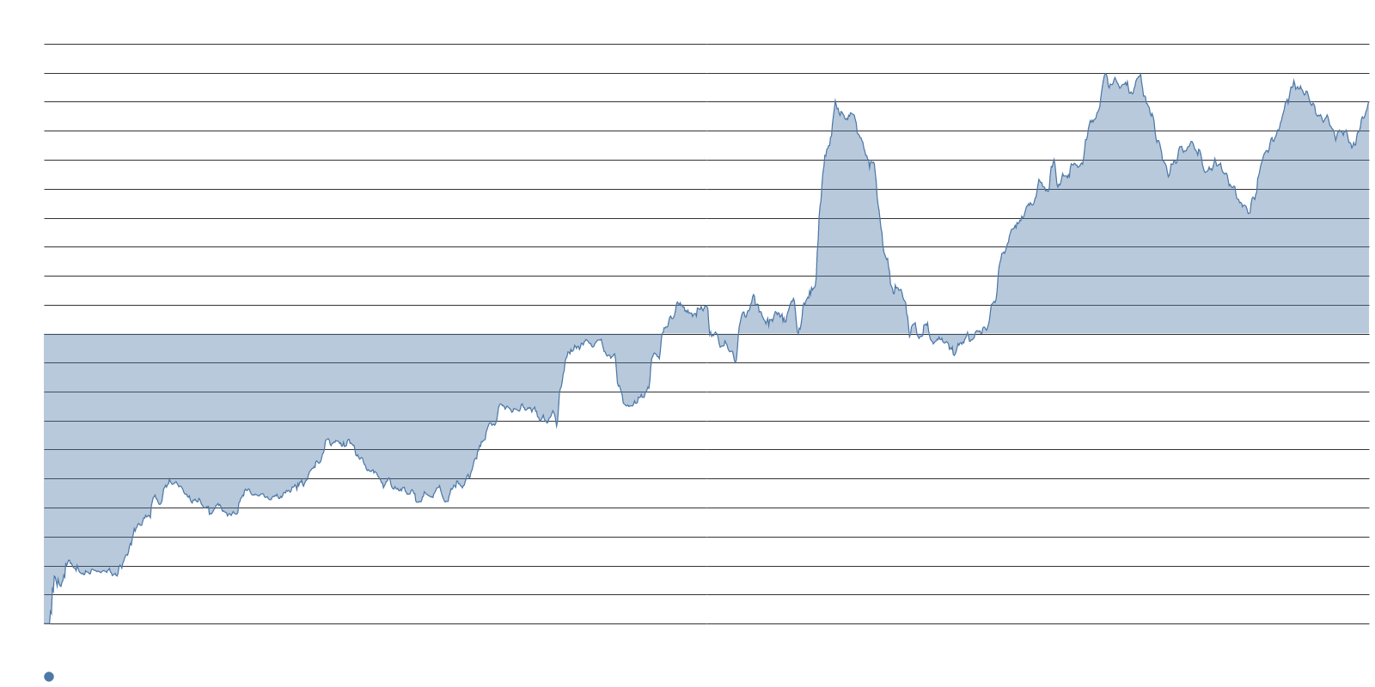
Combined hyperscaler capex guidance has climbed to $720–745 billion for 2026.
CAPEX TRAJECTORY — SPENDING ACCELERATES
80.1
Language asserting AI infrastructure spending is massive and increasing — well above its mean
$4.1T
UBS projection for hyperscaler AI infrastructure spend from 2026 to 2028
102%
Amazon, Alphabet, and Microsoft capex as a share of cloud revenue this year
-7%
Alphabet share decline after raising capex guidance in late July
Combined 2026 capex guidance across the four largest hyperscalers has climbed to $720–745 billion following the latest earnings calls. Fund managers have identified hyperscaler AI spending as the top potential trigger for a systemic credit event.
Language questioning massive hyperscale projects sits above its companion tracking expectations of continued expansion, with both above average — the spending narrative is running hot, but the market is penalizing the spenders.

Slide 10
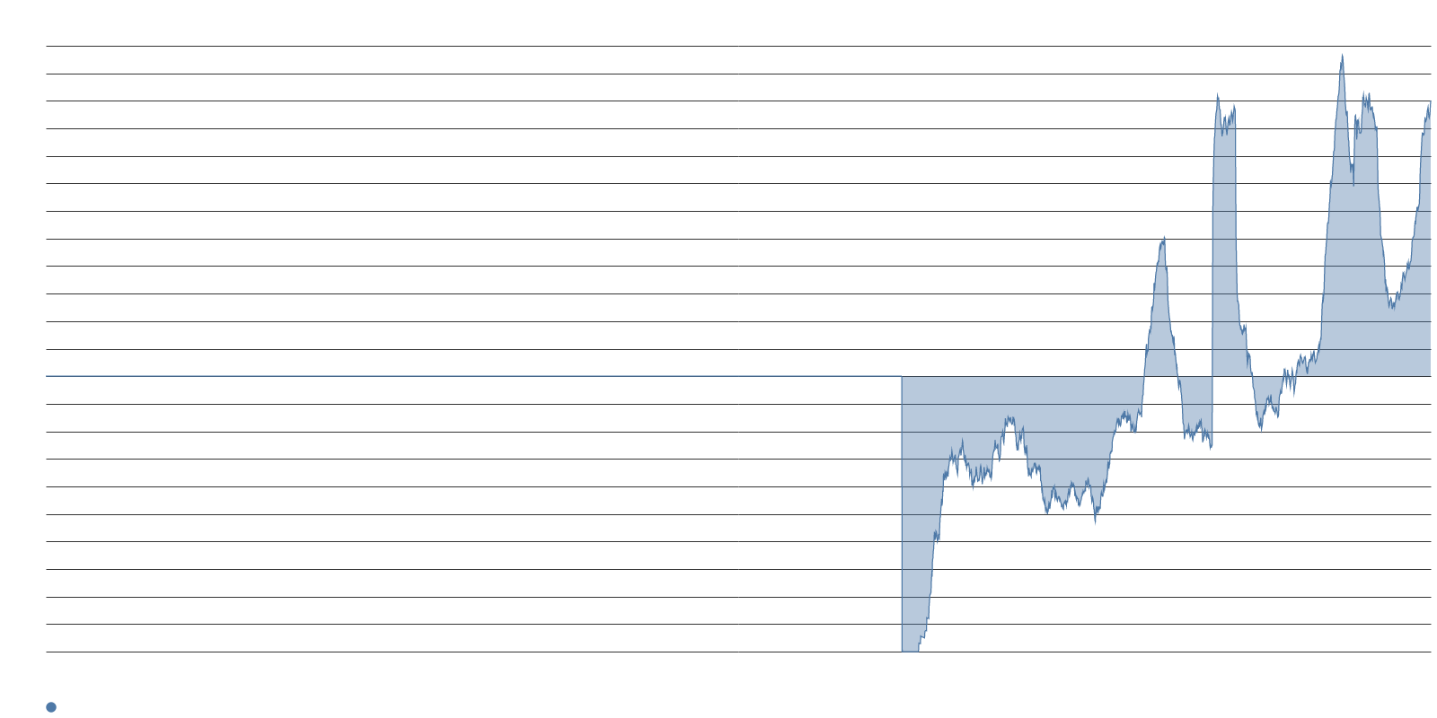
The corporate ROI rebuttal is missing and long-horizon defenses are fading.
PAYOFF CASE — ABSENT AND DECLINING
100.2
Language asserting businesses increasingly doubt large AI spending — about twice its average
-47.0
Language connecting AI to productivity gains and potential UBI — well below average
MIT Project NANDA found that 95% of enterprise generative AI pilots delivered no measurable P&L impact against $30 to $40 billion in spending. S&P Global found that 42% of companies abandoned most AI projects in 2025. Language asserting that AI advances are hitting corporate bottom lines and that non-adopters will be left behind both sit below their means.
The long-horizon defenses are receding fastest — language connecting AI to a multi-decade investment supercycle sits at a similar depth, and the capex case is being defended on near-term demand, not secular-cycle logic.

Slide 11
STORY THREE
Consent, Legitimacy, and Brand
Local opposition surges, the public-benefit case goes quiet, and narrative attention concentrates

Slide 12
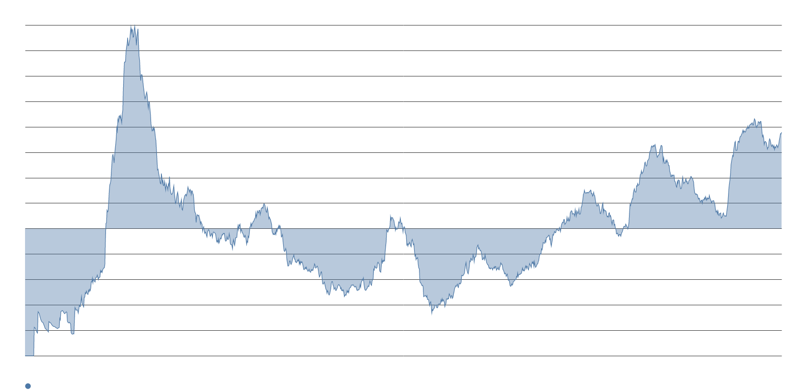
More than 530 communities have restricted data center construction.
LOCAL OPPOSITION — THE BACKLASH ACCELERATES
75.7
Language claiming opposition to large AI investments is increasing
+12.0
Weekly point rise — among the largest weekly increases in the set
75%
Share of Americans opposing a new data center near where they live per Heatmap/Embold
Politico described the late-summer backlash as inspiring panic in parts of the tech sector. Politicians across the spectrum — from Governor Abbott to Josh Shapiro to Michigan Senate nominee Mike Rogers — are embracing curbs on construction. Opposition spans age, income, partisanship, and the rural-urban divide.
Indianapolis finalized a moratorium through end-2027, Louisville adopted a six-month pause, and the Cherokee Nation barred hyperscale facilities from tribal and trust lands after 64% of surveyed citizens opposed them. Counterpressure is real but uneven: Hill County, Texas rescinded its moratorium after a developer sued for over $100 million.

Slide 13
Every public-benefit narrative sits below its long-term mean.
BENEFIT FRAMING — CONSPICUOUSLY ABSENT
-60.5
Language claiming AI will fundamentally change healthcare — well below average
Below
Education and science benefit frames — similarly depressed
Language claiming AI will transform healthcare sits at -60.5, meaning the theme is running at roughly 60% below its long-term average. The education and science equivalents are similarly depressed. Labor framing is quiet on both the job-destruction and job-creation sides, and incumbent-disruption frames around search and news have receded deeply below their averages.
The industry faces organized local opposition without a persuasive answer about what AI is actually for beyond enterprise compute. A handful of firms command narrative share, but no one is supplying the legitimacy story that continued physical build-out would require.

Slide 14
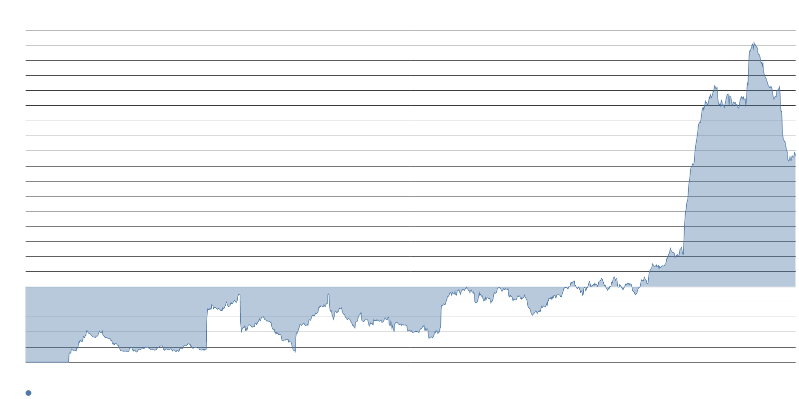
Anthropic commands narrative leadership far above every rival frame.
BRAND ATTENTION — CONCENTRATED AND FRAGILE
173.4
Language asserting Anthropic or Claude leads the AI race — far above rivals
-37.7
Weekly decline in language asserting Grok or xAI leads — the steepest drop in the file
40%
Anthropic's share of enterprise LLM spending per Menlo Ventures vs. OpenAI's 27%
Language asserting Anthropic's leadership holds far above equivalent frames for Google, OpenAI, and China. Menlo Ventures data shows Anthropic at 40% of enterprise LLM spending versus OpenAI's 27%, giving the narrative density a commercial anchor.
Grok-leadership language posted a steep weekly drop to roughly its long-term mean despite Grok 4.6 shipping on 12 August and scoring fourth on the Artificial Analysis Intelligence Index. As Nate Silver noted, the opposition is less about model risk than about distrust of large tech firms themselves.

Slide 15
The AI narrative is splitting into a spending story with no payoff story to match.
SYNTHESIS
Three fractures define this week's language landscape. First, the constraint conversation has moved downstream from chips to memory, power, and physical space — problems that money alone cannot solve on the timeline markets are pricing. Second, the spending narrative keeps climbing while every frame that would justify it — corporate ROI, productivity transformation, a multi-decade supercycle — is receding. Third, local resistance is organized and bipartisan while the public-benefit narratives that could counter it sit at their quietest levels.
The result is a narrative environment in which capital is flowing faster than legitimacy is being built. Coverage describes an industry that can explain what it needs but not what it delivers, and a political system that has found a popular target before the industry has found a popular defense.

Slide 16
Memory economics, the Texas queue, and Q3 earnings will set the next chapter.
WHAT TO WATCH
Dec
Expected conclusion of ERCOT's Batch Zero review for ~300 queued projects
2028
Samsung's timeline for persistent memory crunch
Q3
Next earnings cycle — will hyperscalers shift from demand defense to benefit arguments?
ERCOT's Batch Zero conclusion is now expected in mid-December. If the review clears a material share of the roughly 300 queued projects, construction-delay and interconnect-delay language should ease; if it stalls or shrinks the pipeline further, the Texas narrative could spread to other grid operators.
DRAM and NAND pricing through Q3 will test whether the memory constraint frame stays elevated. Samsung's warning of a deepening crunch through 2028 and IDC's structural-shortage framing give the narrative momentum that a single quarter of loosening supply may not reverse.

