Slide 1
Perscient
Perscient AI Pulse Chartbook
August 18, 2026

Slide 2
Executive Summary
FIVE THINGS TO REMEMBER FROM THIS WEEK'S NARRATIVE LANDSCAPE
01
Crash language and capex conviction rose together, and neither displaced the other.
Language predicting an AI-driven market crash jumped 12.2 points to 135.4 — well above its long-term mean — while language asserting that AI infrastructure spending is massive and increasing gained 9.7 to 75.5. Disillusionment language fell and concentration-risk language slipped, meaning commentators are arguing systemic market risk directly rather than routing it through a 'the technology underdelivered' narrative.
02
The payoff story remains the missing piece keeping both camps in circulation.
Language asserting that promised efficiency improvements have not occurred sat flat at 46.5, and language tying AI advances to company profits remained near baseline. The long-duration arguments — supercycle framing, efficiency-and-UBI framing — weakened, so near-term capex conviction is being asserted without the multi-year justification beneath it.
03
The binding constraint in media coverage has moved from the GPU to memory, sites, and power.
Language asserting that memory shortages are throttling AI growth dominated the file at 459.3, while GPU-scarcity language sat at just 6.6, effectively at its long-term mean. Data center construction delays ranked second at 160.7, and local opposition coverage held firm around moratoriums and community veto proposals.
04
Physical bottlenecks supply the mechanical support for hyperscale doubt.
The bear case circulating this week is less about demand evaporating and more about DRAM sold out through 2027, five-year interconnection queues, and capacity prices rising by an order of magnitude — supply-side and cost-side skepticism, which explains why crash talk can rise even while disillusionment falls.
05
The competitive leaderboard consolidated around Anthropic inside a national energy race.
Language asserting Anthropic or Claude leadership held at 173.7, the strongest competitor reading in the file, backed by $65 billion annualized revenue, positive adjusted operating income, and a confidential IPO filing. Language arguing that energy infrastructure determines AI leadership climbed sharply to 83.0, framing the national contest in electricity rather than silicon.
How to read the numbers: each reading shows how far above or below its long-run average a theme is running in the media — 100 means twice the average; −100 is the floor.

Slide 3
STORY ONE
Crash Talk and Capex Conviction Strengthen in Parallel
Bubble language and spending conviction rise together while the payoff story stays absent

Slide 4
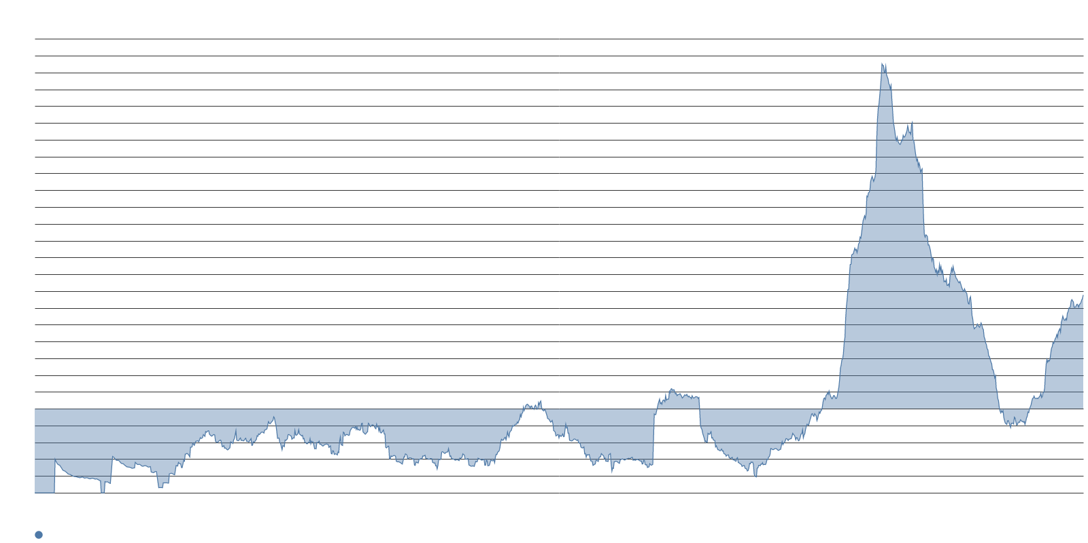
Language warning of an AI-driven market crash posted the week's largest gain among risk measures.
SYSTEMIC RISK LANGUAGE
135.4
Language predicting an AI bubble will bring down the broader market
+12.2
Week-over-week gain — the largest among market-risk measures
52.2
Language asserting that hyperscale projects face growing doubts
Ray Dalio warned that runaway AI enthusiasm mirrors 1929 and 2000, citing excessive leverage and ignored valuations, on the same day Evercore ISI projected the S&P 500 could reach 9,000 — a juxtaposition Benzinga called a stark divergence. ECB researchers added that a correction of current stock market valuations is likely because AI-driven valuations echo the dot-com era.
Language asserting that businesses increasingly doubt large AI spending, that infrastructure spending is a dangerous gamble, and that hyperscale projects face skepticism all moved higher together. The three doubts are converging rather than taking turns.

Slide 5
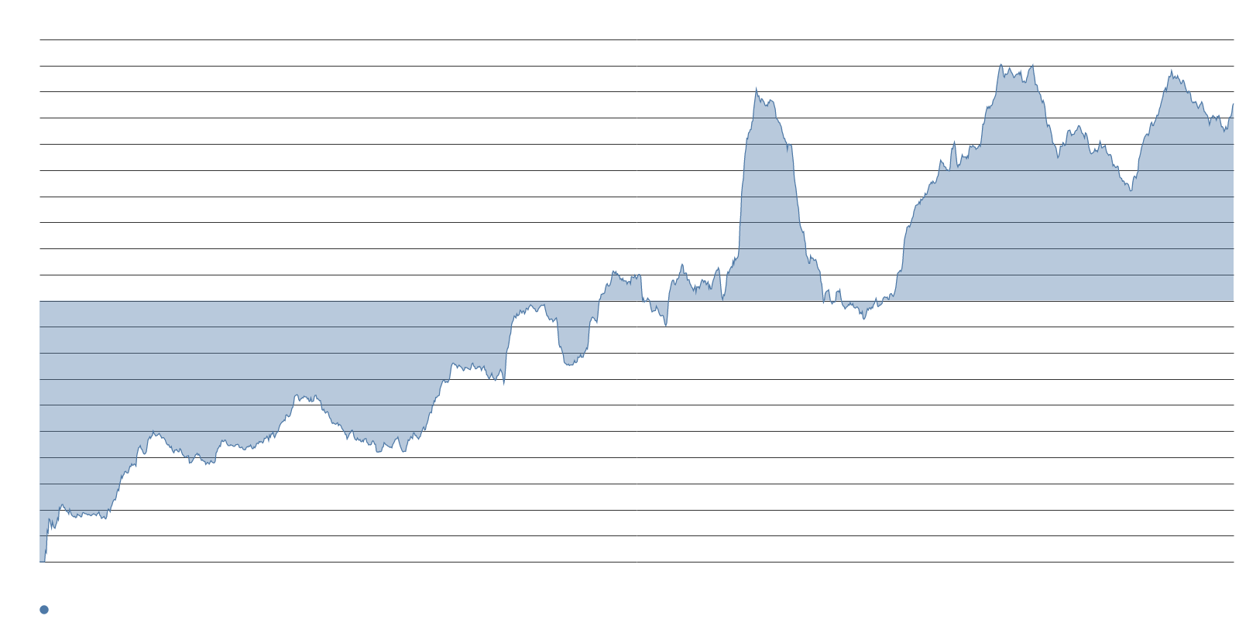
The bull case strengthened simultaneously — capex conviction and crash talk are not trading off.
CAPEX CONVICTION VS. CRASH FRAMING
75.5
Language asserting AI infrastructure spending is massive and increasing
-25.2
Language claiming AI hype is giving way to disappointment — below baseline
Reuters reported that capex angst is fading among big investors who now treat today's capex as tomorrow's sales. Capex-conviction language gained 9.7 points on the week, and J.P. Morgan lifted its year-end S&P 500 target to 8,000, arguing that elevated backlogs converting into recognized revenue should validate rising AI capex.
Language claiming AI hype is giving way to a disappointment phase declined, and concentration-risk language also slipped. Commentators are arguing systemic market risk directly, not routing it through 'the technology underdelivered.'

Slide 6
The payoff story is the missing piece that keeps both bulls and bears in circulation.
EFFICIENCY AND PROFIT LANGUAGE
46.5
Language asserting that promised AI efficiency improvements have not occurred
~0
Language tying AI advances to company profits — near its long-term mean
$725B
Planned 2026 capex by the four largest hyperscalers — up ~77% year over year
Bloomberg identifies rates, not AI fundamentals, as the swing factor, noting that AI capital expenditures are not expected to fully pay off for years, while the four largest hyperscalers plan roughly $725 billion of 2026 capex, up about 77% from last year. An NBER study found that 89% of managers saw no productivity change over three years even as 91% of companies report AI use.
Apollo's Torsten Slok argued that chipmakers' 41% margins depend on model makers' negative 59% operating margins staying financeable. Near-term capex conviction is being asserted without the long-duration justification that would normally sit beneath it.

Slide 7
STORY TWO
The Bottleneck Shifts From GPUs to Memory, Sites, and the Grid
Memory scarcity, construction delays, and local opposition have become AI's defining supply stories

Slide 8
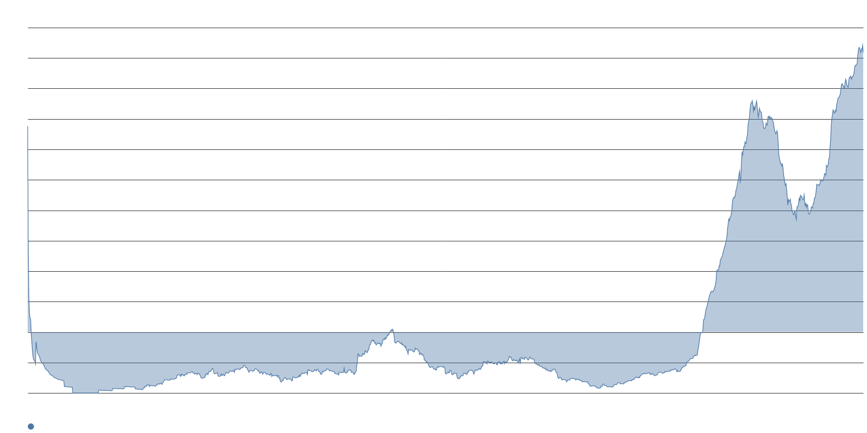
Memory scarcity has become AI's defining supply story, far eclipsing GPU shortages.
MEMORY VS. GPU CONSTRAINT LANGUAGE
459.3
Language asserting that memory shortages are throttling AI growth — the file's top reading
6.6
Language asserting GPU shortages are slowing AI growth — at its long-term mean
400%+
J.P. Morgan's estimate of DRAM price increase from early 2024 through end of 2026
Samsung, SK hynix, and Micron have now sold their entire DRAM and HBM production capacity through 2027. IDC forecasts data centers will absorb about 70% of all memory produced worldwide in 2026, up from 20–30% as recently as 2022, with supply growth well below historical norms.
Tim Cook called the market "a 100-year flood on memory pricing," and widely shared posts noted demand growing near 200% against roughly 20% supply growth, with German DDR5 retail prices at five times their July 2025 levels.

Slide 9
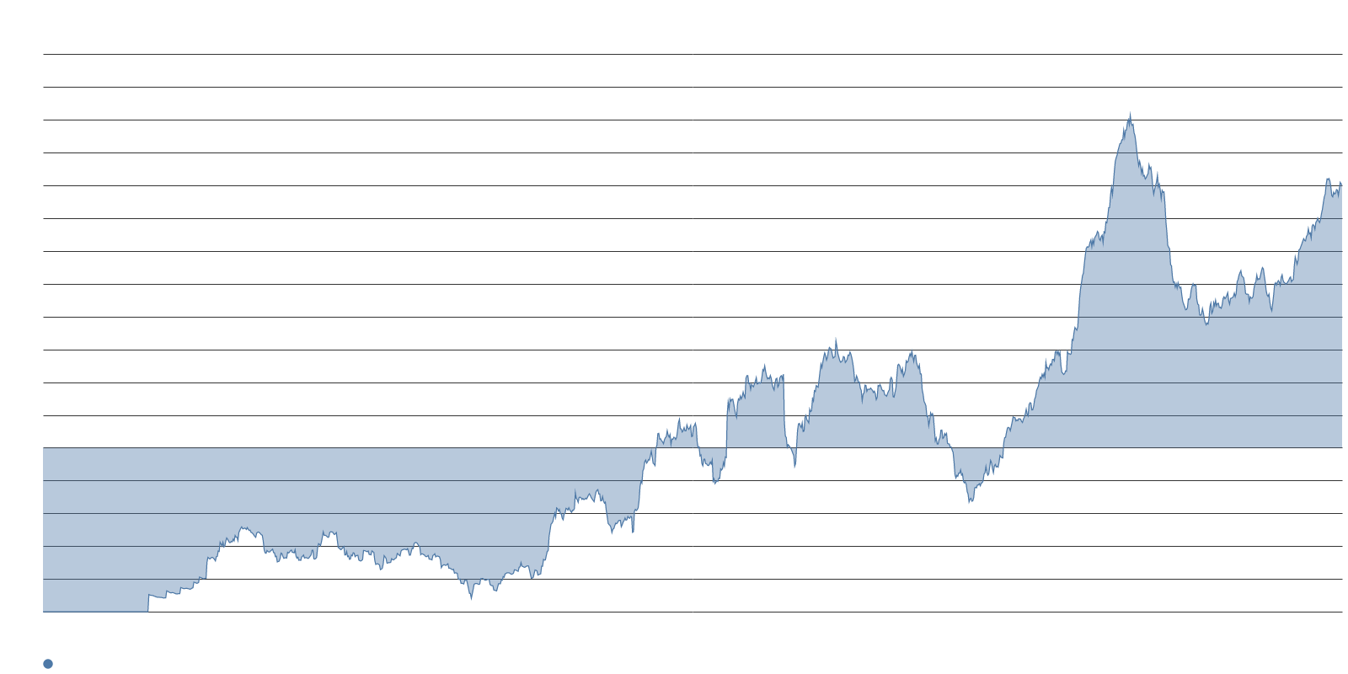
Data center construction delays rank second, and grid interconnection remains elevated.
SITES AND GRID CONSTRAINT LANGUAGE
160.7
Language asserting data center construction delays are slowing AI growth
2,600
GW in the U.S. interconnection queue
~5 yrs
Median wait for grid interconnection
$329.2
PJM capacity price per MW-day for 2026/27 — up from $28.9 in 2024/25
FERC directed regional grid operators to disclose spare capacity and file revised interconnection tariffs, requiring data centers to pay the full cost of their own grid upgrades. PJM asked FERC on August 13 for a framework allowing large new loads to connect early in exchange for accepting curtailment when capacity falls short, citing roughly 70 GW of expected new large-load demand by 2038.
Grid interconnection language moderated on the week yet remains one of the strongest constraint readings — the physical backlog is unchanged even as the regulatory framework shifts.

Slide 10
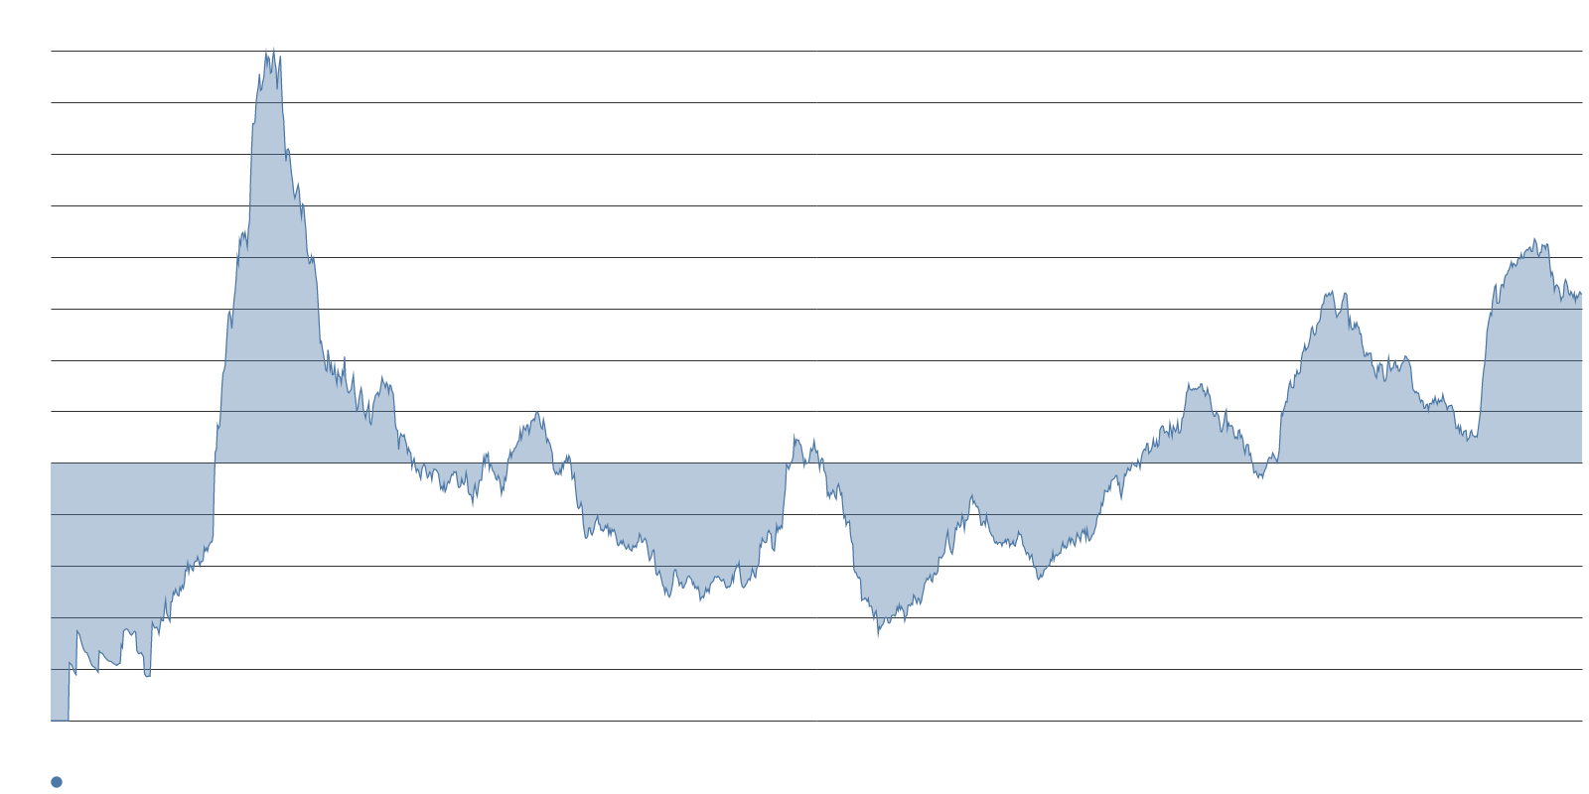
Local opposition to data centers holds firm around moratoriums and congressional proposals.
COMMUNITY RESISTANCE LANGUAGE
65.7
Language asserting opposition to large AI capital projects is increasing — flat on the week
71%
Americans opposed to a data center near them — March Gallup survey
Rep. Ro Khanna pressed his Data Center Bill of Rights on Meet the Press, arguing local communities should decide whether facilities get built. During the week, Fort Worth's City Council voted unanimously toward a 90-day moratorium, Maryland counted 13 county-level moratoriums and one outright ban, and Colorado localities enacted their own pauses.
These physical bottlenecks are the most credible mechanical support for the doubts about hyperscale projects discussed in the financial coverage — supply-side and cost-side skepticism rather than demand-side.

Slide 11
STORY THREE
A Two-Firm Commercial Race Inside a Two-Nation Energy Race
Anthropic consolidates the leaderboard while national competition is reframed in electricity

Slide 12
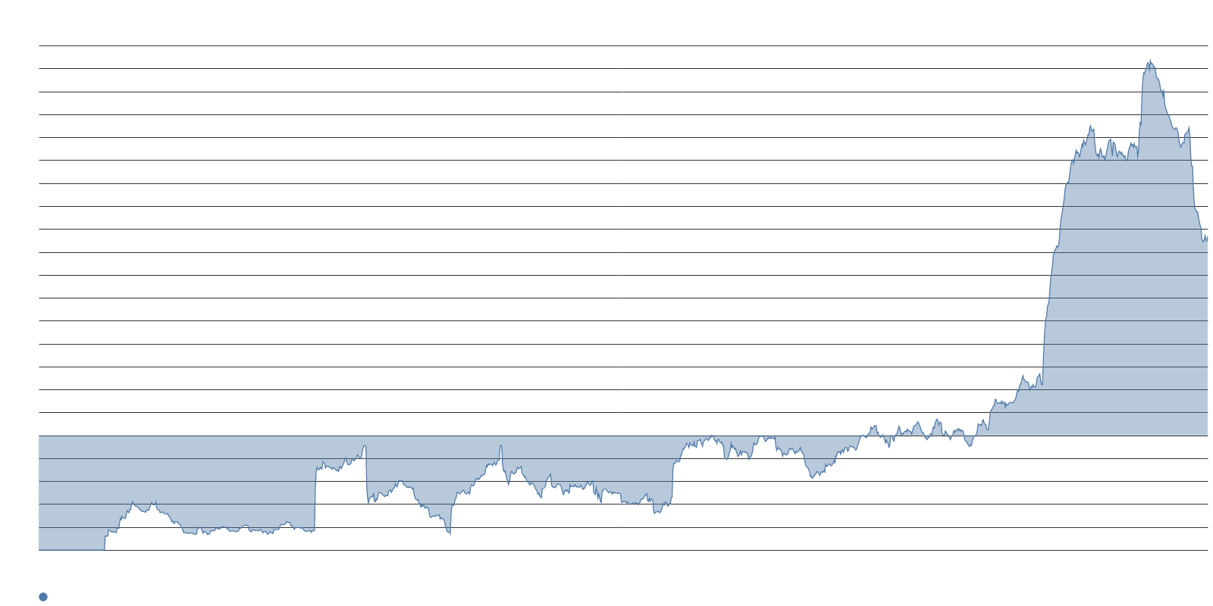
Anthropic holds the strongest competitor-leadership reading, backed by revenue and an IPO filing.
COMPETITIVE LEADERBOARD — ANTHROPIC
173.7
Language asserting Anthropic or Claude leads the AI competition — the strongest competitor reading
$65B
Anthropic's annualized revenue run rate by end of July — up 7x from end of 2025
$11.5B+
Preliminary quarterly revenue — against $787M a year earlier
Anthropic has filed confidentially for an IPO with Morgan Stanley, Goldman Sachs, and JPMorgan and could trade as early as this fall, ahead of OpenAI. The valuation hinges on 2028 revenue projections of roughly $190–200 billion.
Anthropic's disclosed revenue and positive adjusted operating income are now being deployed as counter-evidence against the market-crash framing — the payoff story that is absent economy-wide has arrived for at least one company.

Slide 13
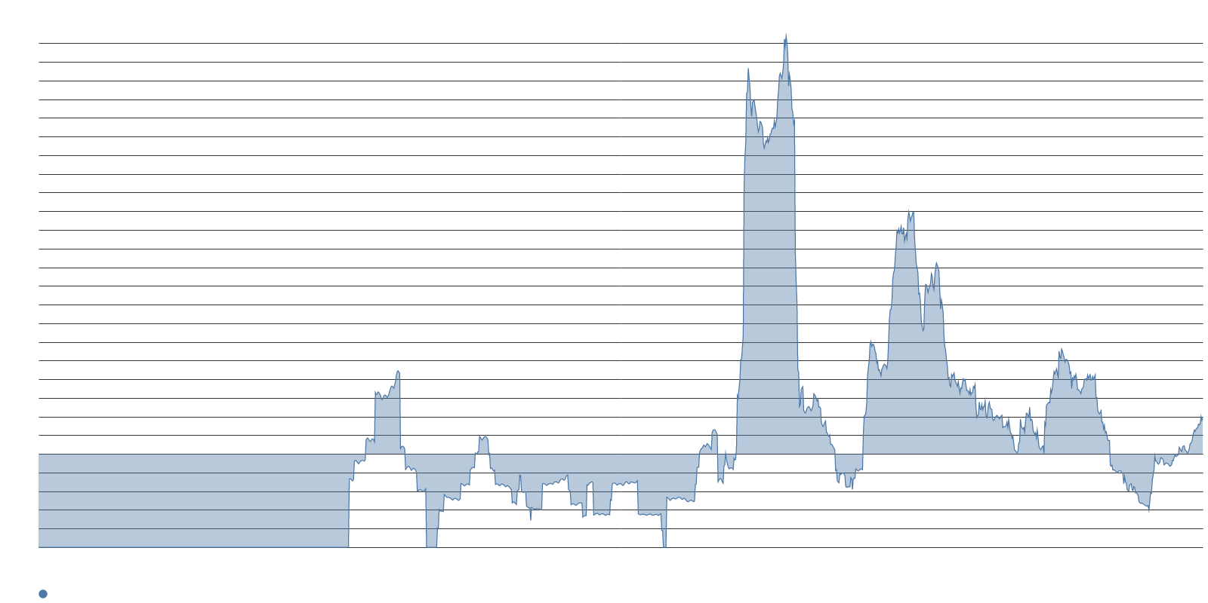
OpenAI and Google sit below baseline while Grok and DeepSeek posted the fastest weekly gains.
COMPETITIVE MOVERS — GROK AND DEEPSEEK
38.5
Language asserting Grok or xAI leads — up 10.8, the fastest mover among competitors
32.8
Language asserting DeepSeek or China leads — up 9.5 on V4-Pro general availability
Grok 4.6 shipped on August 12 as a frontier agentic and coding model priced at $2 per million input tokens and $6 per million output tokens, drawing enthusiastic early reviews and a tie for the top spot on the Artificial Analysis Agentic Index. Grok 5 has not shipped and has no model card or public benchmark; the language is tracking cadence and expectation.
DeepSeek V4-Pro reached general availability on August 13, focused on agentic tool use, with peak output pricing raised to $4.0 per million tokens — still below Western frontier pricing. Meanwhile, language asserting OpenAI or Google leads remains flat and below its long-term mean; OpenAI's run rate sits at about $40 billion on most recently disclosed figures.

Slide 14
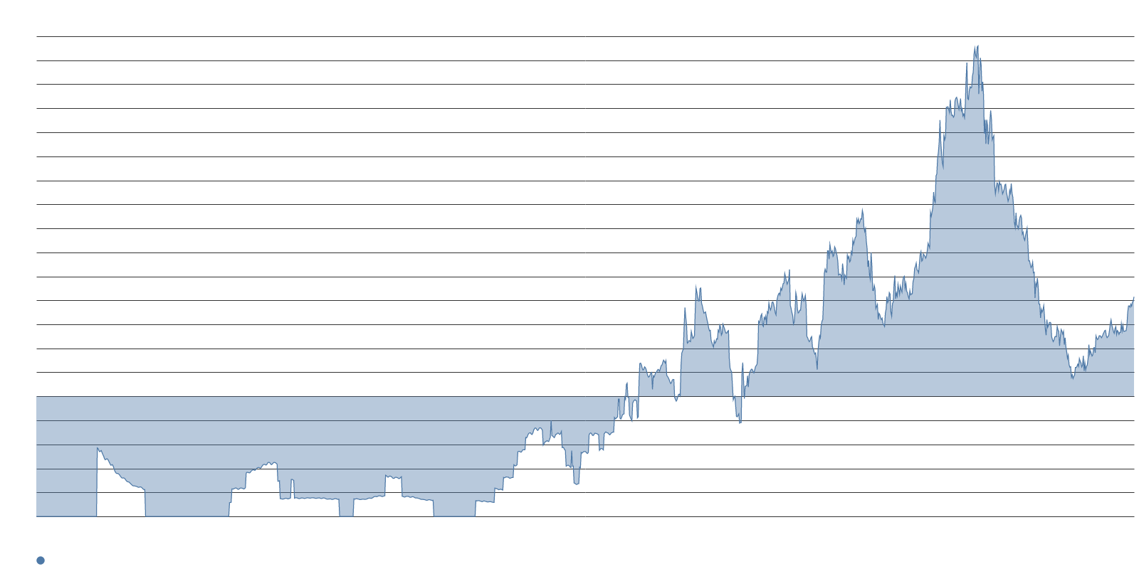
The national race is being reframed in electricity rather than silicon.
ENERGY AS THE AI LEADERSHIP DETERMINANT
83.0
Language asserting the country that builds the best energy infrastructure will lead in AI
+7.7
Week-over-week gain — one of the larger weekly moves in the file
100 GW
New annual U.S. generating capacity OpenAI has urged — electricity framed as strategic asset
Supporting coverage argues China added grid power at roughly eight times the U.S. pace in 2025. Mark Zuckerberg warned that China is bringing online more than a gigawatt of nuclear capacity every other week, and OpenAI has urged up to 100 GW of new annual U.S. generating capacity, calling electricity a strategic asset.
The energy frame links the competitive story directly to the grid constraints above it, and positions Anthropic's disclosed financials as counter-evidence against the crash narrative — one thread tying all three stories together.

Slide 15
Three narratives that usually compete are reinforcing each other this week.
SYNTHESIS
135.4
Crash-language density — well above average, rising alongside capex conviction
459.3
Memory-scarcity language — the file's dominant reading and the bridge between risk and supply
Crash talk and capex conviction rose together because the bear case this week is supply-side, not demand-side. Commentators are warning of a 1929- or 2000-style unwind while simultaneously reporting that capex angst is fading — a pairing that only makes sense if the risk argument is about physical bottlenecks and cost pressure, not about the technology underdelivering.
Memory sold out through 2027, five-year interconnection queues, and capacity prices rising by an order of magnitude provide the mechanical link. These constraints feed the crash framing directly, while Anthropic's financials offer the one concrete payoff data point in circulation — enough to sustain capex conviction but not enough to close the broader payoff gap.
The result is a narrative landscape where bulls and bears are both getting louder, drawing on different parts of the same supply-chain reality.

Slide 16
The IPO window, competitor pricing, and national energy metrics will move all three narratives at once.
WHAT TO WATCH
Anthropic's IPO timeline. A fall listing ahead of OpenAI would provide the first public-market test of whether disclosed AI revenue and positive operating income can resolve the payoff-story gap that is sustaining both the bull and bear cases simultaneously.
Competitor pricing moves. Grok 4.6 and DeepSeek V4-Pro shipped at aggressive price points this week. Further price compression — or margin-negative pricing persisting — will feed the skeptics' argument that chipmakers' margins depend on model makers' losses staying financeable.
National energy build metrics. Language framing AI leadership in electricity rather than silicon climbed sharply. Watch for U.S. grid capacity announcements, Chinese nuclear commissioning data, and any policy response to FERC's revised interconnection framework — these will set the pace for how quickly the bottleneck story evolves.

