Slide 1
Perscient
AI Pulse Chartbook
June 9, 2026

Slide 2
Executive Summary
FOUR THINGS TO REMEMBER FROM THIS WEEK'S NARRATIVE LANDSCAPE
01
AI's binding constraints have rotated from GPUs to physical infrastructure.
Three of four infrastructure-constraint signatures strengthened this week — memory (340.8), interconnects (153.3), and data center delays (112.8) — while the GPU shortage signature fell to 10.8. The bottleneck conversation now centers on power, cooling, and construction.
02
Anthropic dominates the competitive narrative while every rival sits at or below average.
The Anthropic/Claude signature reached 390.5, up 17.3 points, while xAI/Grok posted a sharp 13.6-point decline to −57.7. A confidential IPO filing, a call for a global development pause, and leaked Claude Mythos reports converged to amplify the frontrunner framing.
03
Capital commitment and bubble anxiety are strengthening in tandem.
The AI-bubble-crash signature rose 17.9 points to 3.1, while AI capex language strengthened to 95.3. Combined hyperscaler capex is expected to exceed $500 billion this year, yet 90% of firms report no productivity impact from AI.
04
The gap between committed spending and deliverable infrastructure defines the tension.
Only 5 GW of a 16 GW announced pipeline is under construction. Grid connections take five to seven years against a 12-to-18-month build cycle. This mismatch explains why spending enthusiasm and spending doubt are rising together.

Slide 3
STORY ONE
The Infrastructure Wall
Memory, power, and interconnect constraints have replaced GPUs as AI's binding limits

Slide 4
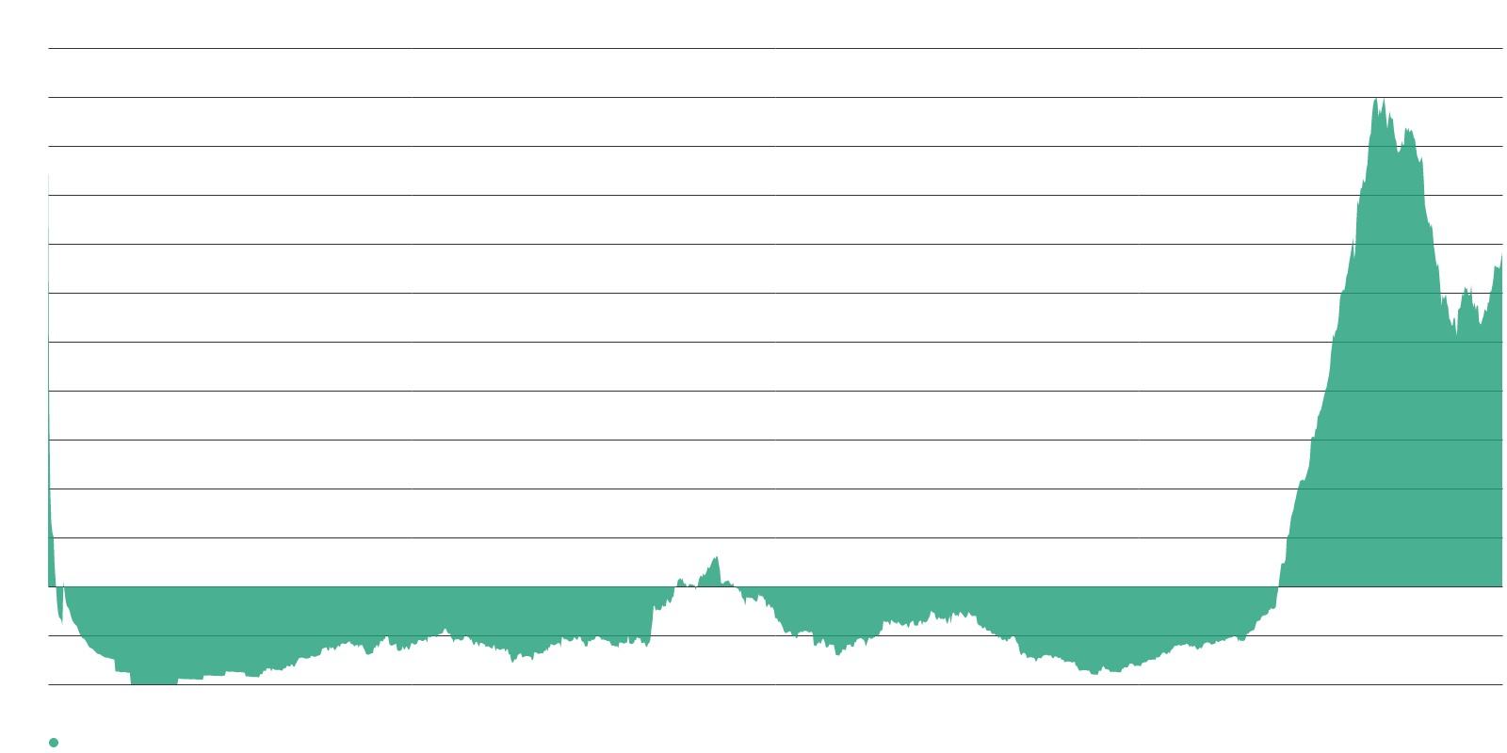
Memory scarcity has become AI's defining supply-chain story.
RAM SHORTAGE SIGNATURE AT 340.8
340.8
RAM shortage signature — up 13.0 pts this week
30%
Share of hyperscaler AI spend on memory in 2026, up from 8%
$62.7
DRAM price — elevated peak per 1Buy weekly report
Memory now dominates the constraint narrative. The signature tracking language asserting that RAM shortages are slowing AI growth reached 340.8, up 13.0 points this week. SemiAnalysis estimates memory could account for roughly 30% of hyperscaler AI spending in 2026, up from about 8% in 2023–2024.
The tightness is structural. Samsung, SK Hynix, and Micron have reallocated production toward high-bandwidth memory used in AI accelerators, which generates three to five times higher margins than conventional DRAM. Contract prices rose 60% in Q1 2026, and 70% of memory production is now allocated to AI infrastructure. Intel CEO Lip-Bu Tan sees no relief until 2028.

Slide 5
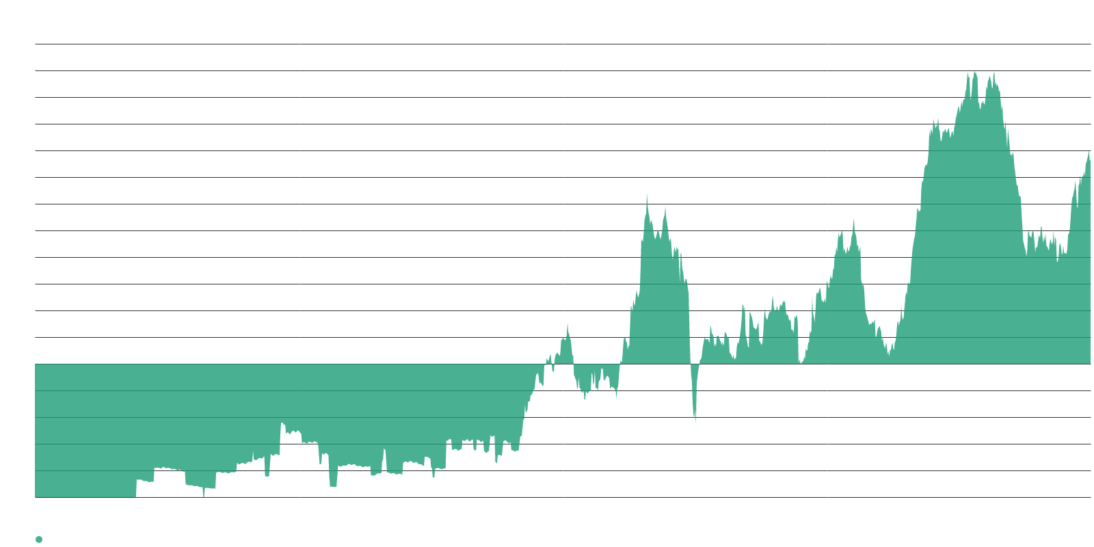
Grid connection timelines dwarf the data center build cycle.
INTERCONNECT AND DATA CENTER DELAYS
153.3
Interconnect delays signature — up 12.3 pts
112.8
Data center build delays signature — up 11.3 pts
Construction outpaces the grid. Against a 16 GW announced 2026 pipeline, only about 5 GW is actually under construction. Goldman Sachs projects U.S. data center power demand will more than double to 66 GW in 2027 from 31 GW in 2025, but only 50–60% of capacity scheduled for the next one to two years is expected to come online on time.
Transformer shortages compound the problem. Demand increased 119% from 2019 to 2025, but manufacturing capacity has not kept pace, with lead times stretching to five years. Almost half of U.S. data centers expected to come online in 2026 have been pushed back or canceled.

Slide 6
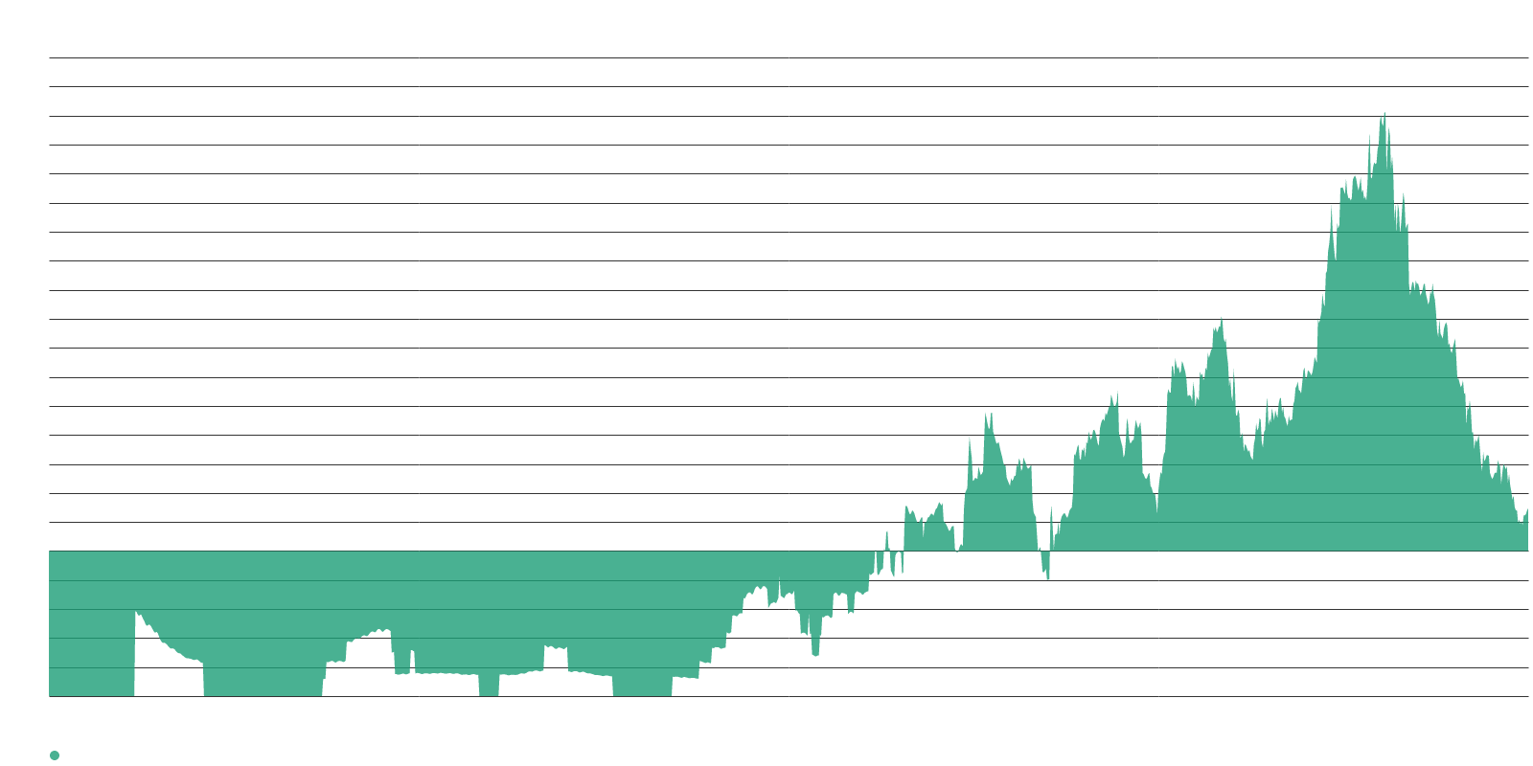
Energy infrastructure is emerging as the arbiter of AI leadership.
ENERGY CAPACITY AND AI COMPETITIVENESS
29.5
Energy-determines-AI-leadership signature — up 10.9 pts
68 GW
RAND estimate — global AI data center power need by 2027
10.8
GPU shortage signature — down 6.0 pts, fading from the frame
The constraint hierarchy has flipped. The GPU shortage signature fell 6.0 points to 10.8 while three physical-infrastructure signatures climbed. The bottleneck frame in media coverage has rotated: the binding constraints on AI are no longer about chip fabrication but about powering, cooling, connecting, and housing the systems those chips go into.
Anthropic has projected that the U.S. AI sector alone will need 50 GW of new electric capacity by 2028 to maintain global leadership — a figure that reframes AI competition as an energy-policy question.

Slide 7
STORY TWO
Anthropic's Ascent
A confidential IPO filing, a global-pause call, and Claude Mythos tilt the race

Slide 8
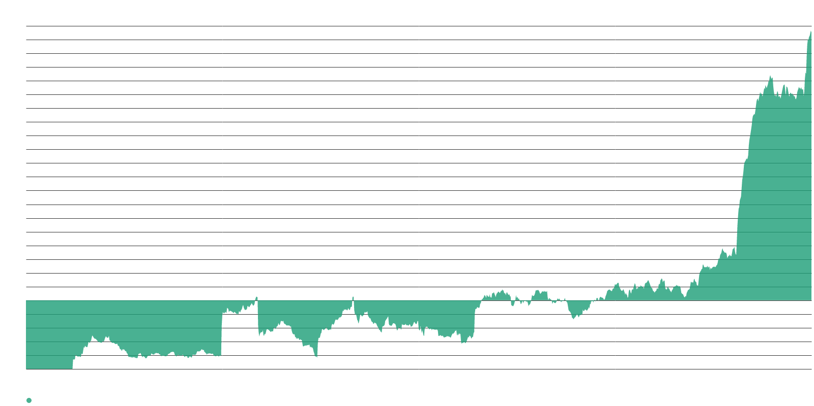
Anthropic's competitive narrative has reached an exceptional concentration.
ANTHROPIC/CLAUDE SIGNATURE AT 390.5
390.5
Anthropic/Claude signature — up 17.3 pts this week
$965B
Most recent private valuation, surpassing OpenAI's $852B
80%
Share of Anthropic code now autonomously written by Claude
Three catalysts converged this week. Anthropic filed a confidential IPO with the SEC, edging ahead of OpenAI in the race to public markets. The company published a blog post urging a coordinated global pause in frontier AI development. And leaked reports of a forthcoming Claude Mythos release added further momentum.
Claude Mythos Preview achieved a 52x speedup over baseline code on optimization tasks, approaching what some describe as recursive self-improvement. If rumored pricing holds, the release would put serious pressure on every competitor in the premium AI segment.

Slide 9
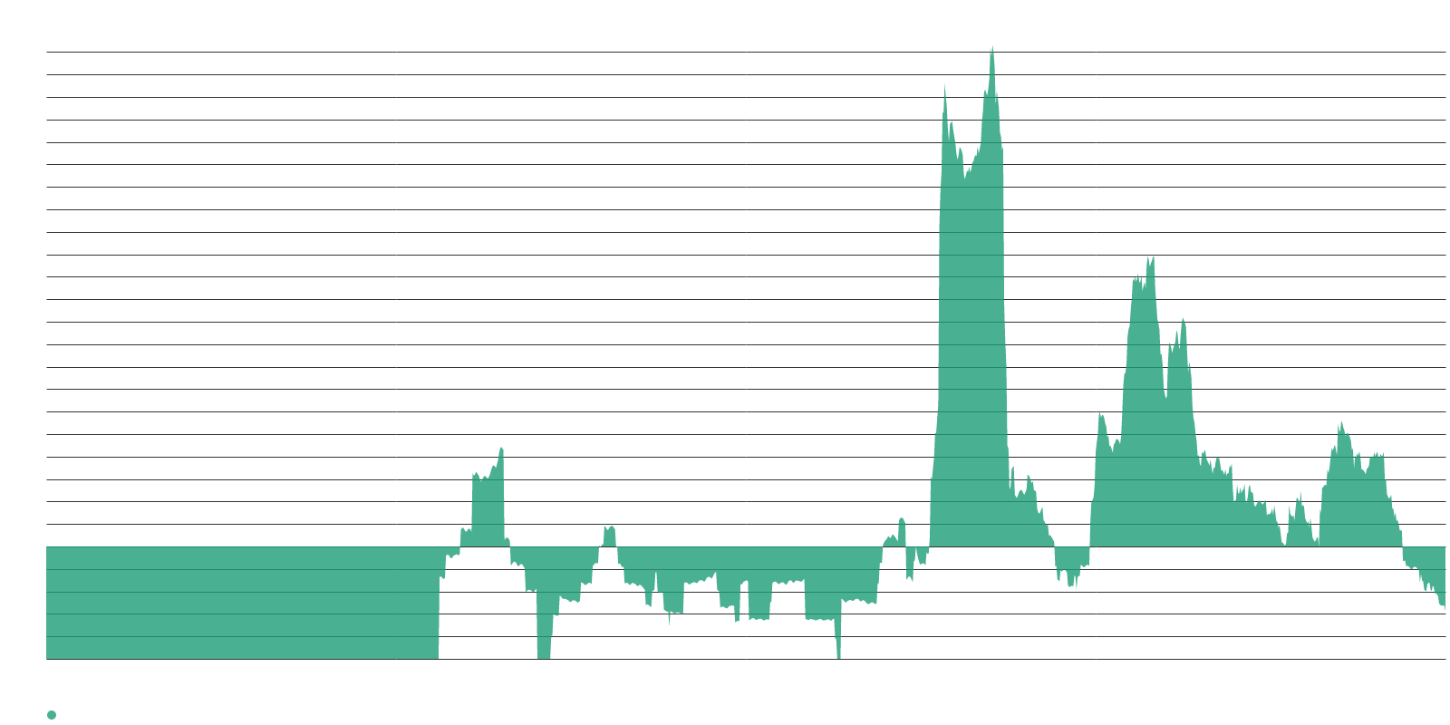
Every other competitor signature sits at or below its long-term average.
THE REST OF THE AI RACE
−57.7
xAI/Grok — down 13.6 pts, a sharp weekly decline
−47.3
OpenAI — flat, well below its long-term average
23.6
Google/Gemini — steady, the only other above-average rival
−34.3
Deepseek/China — faded considerably since early 2025
xAI's narrative is in freefall. Grok app downloads fell nearly 60% from their January peak to around 8.3 million in April. Musk's xAI has paused hiring for specialists to train its Grok chatbot, and amid reports of departing top engineers, Musk admitted xAI "was not built right first time around."
Deepseek/China has faded to −34.3, suggesting the China competitive-threat narrative has receded considerably since early 2025. The competitive picture is strikingly lopsided: Anthropic at 390.5, Google at 23.6, and every other competitor below average.

Slide 10
Scaling pressures may eventually erode the goodwill sustaining Anthropic's position.
NARRATIVE FRAGILITY
52x
Claude Mythos speedup over baseline on optimization tasks
An initial burst of goodwill is not always durable. WhyTryAI observed that uptime issues, poor PR decisions, and subpar product launches can erode a company's market positioning regardless of how strong its technology lead appears. The degree of narrative concentration around a single company is unusual and raises the question of whether operational pressures will catch up.
The competitive picture is strikingly lopsided — and that lopsidedness itself may be the most important signal to watch in the weeks ahead.

Slide 11
STORY THREE
The Capital Paradox
Capex enthusiasm and bubble anxiety strengthen together in an unusual tandem

Slide 12
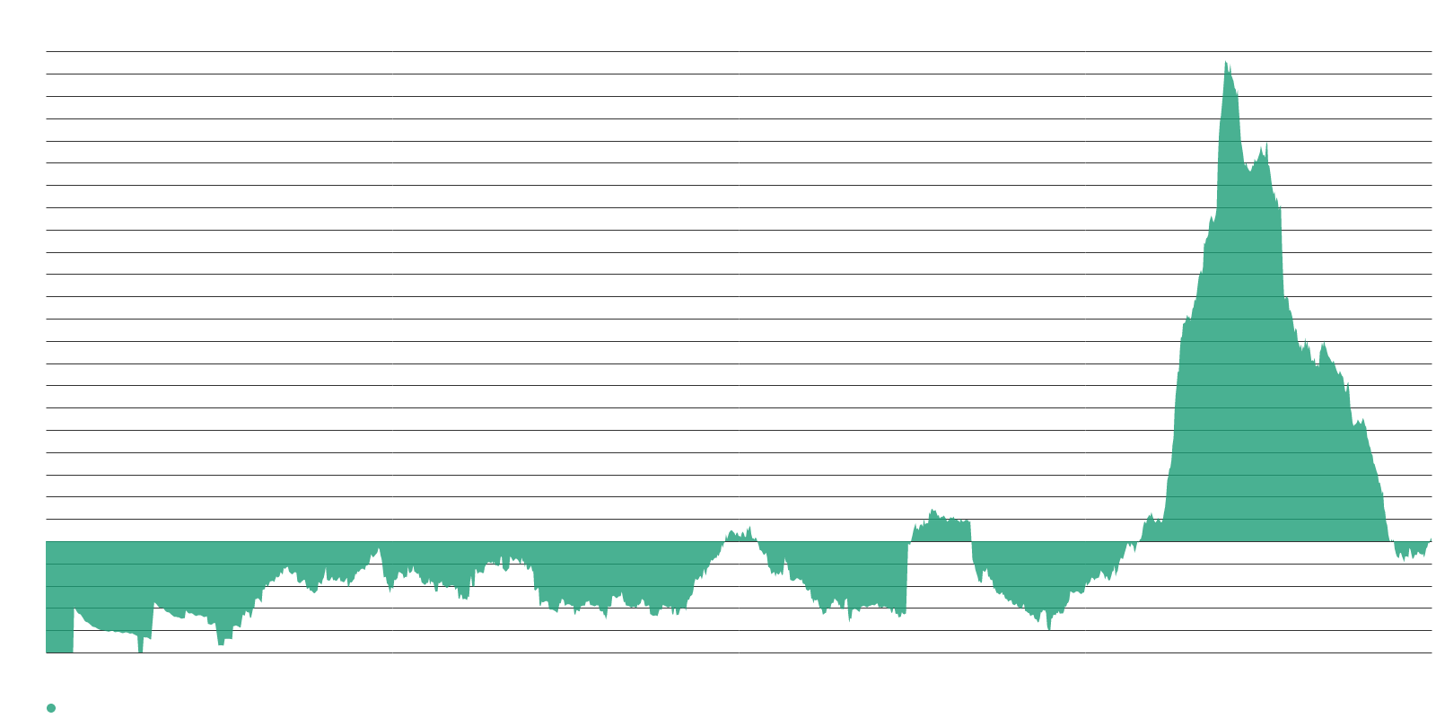
The AI bubble-crash narrative returned to its long-term average in a single week.
BUBBLE ANXIETY SIGNATURE JUMPS 17.9 POINTS
+17.9
AI-bubble-crash signature — a sharp single-week jump
3.1
Current level — back near its long-term average
95.3
AI capex-is-massive signature — up 5.2 pts
Both sides of the capital argument strengthened. The signature tracking predictions that an AI collapse will crash markets rose 17.9 points to 3.1, returning to approximately its long-term average after a sustained period below it. Simultaneously, the signature tracking massive AI infrastructure spending climbed to 95.3, and the long-term supercycle signature remained well above average at 76.8.
These narratives are rising in tandem rather than trading off against one another — an atypical pattern that defines a tense and internally contradictory media environment.

Slide 13
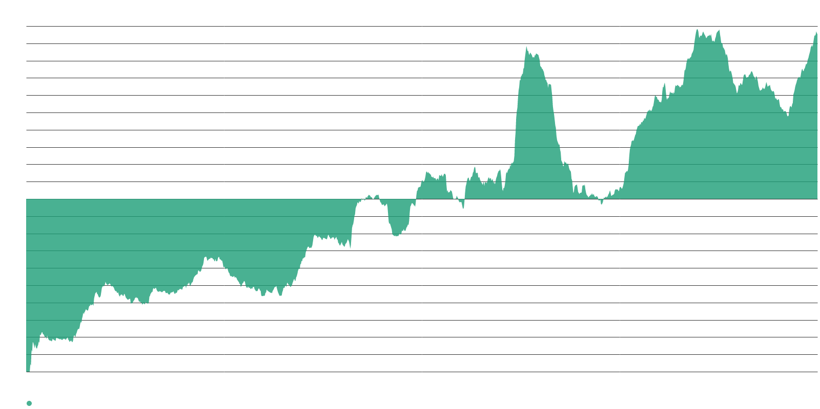
Hyperscaler capex will exceed $500 billion this year with trillions more ahead.
THE CAPEX NUMBERS
$500B+
Combined hyperscaler capex expected in 2026
$7.6T
Goldman Sachs cumulative AI spend projection, 2026–2031
The spending figures are staggering. Bloomberg reported that Alphabet, Meta, Microsoft, and Amazon will rack up combined capex exceeding $500 billion this year. Goldman Sachs' baseline model implies $765 billion in annual AI capex in 2026, with cumulative spending between 2026 and 2031 projected at roughly $7.6 trillion.
Even cash-rich hyperscalers are tapping external capital. Alphabet upsized its equity raise to $84.8 billion from $80 billion announced just two days earlier. BCA Research analysts noted this signals the AI capex cycle is entering an increasingly mature and capital-intensive phase.

Slide 14
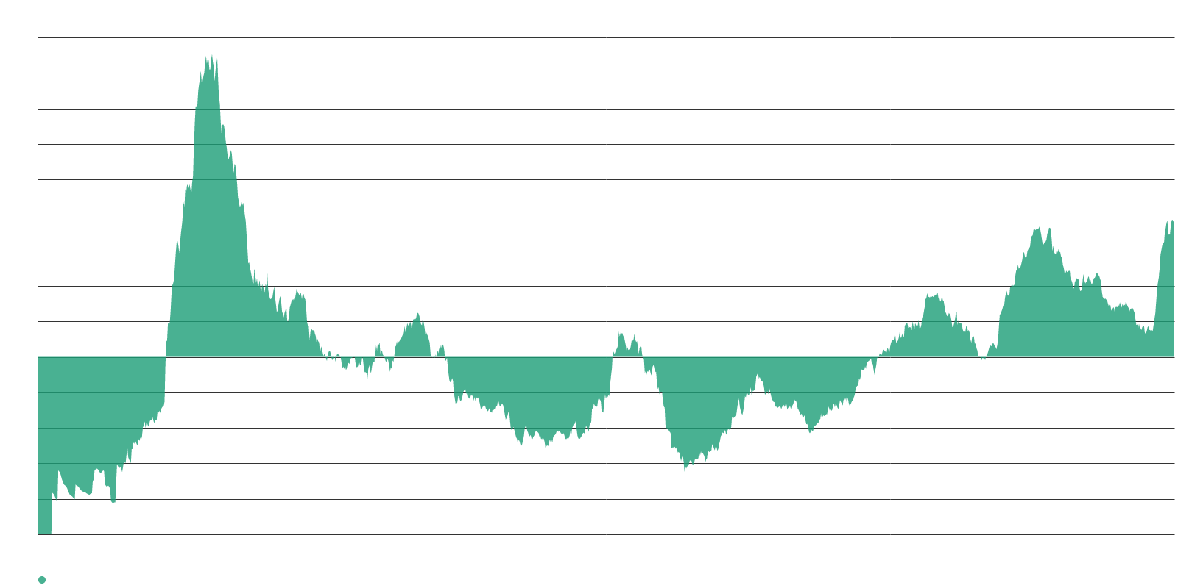
Circular capital flows and absent productivity gains fuel the skeptics.
THE SKEPTICISM CLUSTER
76.9
Resistance to big AI projects — up 7.7 pts
39.5
Business skepticism of AI spending — up 5.8 pts
90%
Firms reporting no AI productivity impact (NBER, Feb 2026)
The skeptics have a structural argument. One prominent analyst argues that a significant share of frontier model companies' revenue is coming from other AI companies — circular capital flows in which investment capital is immediately spent on compute from cloud hyperscalers, counted as revenue, raising valuations and supporting continued investment.
Even the bull case contains cracks. Wells Fargo described the AI trade as a "euphoric" bubble and recommended clients buy into it. But the signature tracking AI-trade durability declined 5.3 points to 40.8, and the businesses-must-adopt-AI signature fell 3.6 to 12.4.

Slide 15
The gap between committed capital and deliverable infrastructure connects every story.
SYNTHESIS
The physical bottleneck story and the capital story are deeply intertwined. Hundreds of billions in announced investment confront grid delays, transformer shortages, and memory allocation constraints that prevent that capital from translating into operational capacity on schedule. This mismatch helps explain why the media can simultaneously describe AI investment as both immense and potentially fragile.
Signatures tracking spending enthusiasm and spending doubt both strengthened this week rather than trading off against one another. The simultaneous rise of infrastructure-constraint narratives, a single dominant competitor narrative, and a split capital narrative marks a media environment defined less by directional conviction than by structural tension.
The question is no longer whether the capital is being committed — it is whether the physical world can absorb it fast enough to justify the pace.

Slide 16
Three signals to track in the weeks ahead.
WHAT TO WATCH
Memory allocation vs. demand. DRAM prices, HBM production share, and whether Intel's 2028 relief timeline holds or accelerates. Any softening in the RAM shortage signature would signal a meaningful shift in the constraint hierarchy.
Anthropic's IPO mechanics and competitor response. The confidential filing opens a clock. Watch for OpenAI's counter-move, any pricing details on Claude Mythos, and whether the narrative concentration around a single company begins to diversify or intensifies further.
Capex-to-capacity conversion rates. The 5 GW vs. 16 GW gap between construction and announced pipeline is the single most telling data point. If Goldman's 50–60% on-time delivery estimate worsens, expect the bubble-anxiety and infrastructure-constraint signatures to continue their joint ascent.

